Slide 1
THE 2025 TECH WAVE
Julius Solaris

Slide 2
Get the slides + 8 Frameworks

Slide 3
IT’S BEEN A CRAZY YEAR
9 Million read my content this year
CEOs, Fortune 500, Tech, and large events in the industry
20K Newsletter Subscribers

Slide 4
CLIENTS
CLIENTS

Slide 5
HOW?

Slide 6
+
The majority of planners are either very or extremely optimistic about 2024
75%
ON AVERAGE
Source: Multiple Sources

Slide 7
GROWTH WILL CONTINUE IN 2025 - REGGIE AGGARWAL

Slide 8
IS YOUR EVENTTECH EXPENDITURE
50.3%
ABOUT THE SAME
42.9%
UP
6.8%
DOWN

Slide 9
KEY TRENDS FOR
SMALL VS LARGE
EVENTS
EVENT SIZE
SMALL EVENTS
LARGE EVENTS
TREND Strength (%)

Slide 10
TRENDS FOR EVENT PLANNERS BY NUMBER OF EVENTS
EVENT PLANNING VOLUME
MANY EVENTS
FEWER EVENTS
TREND Strength (%)

Slide 11
TRENDS BY EVENT TYPE: VIRTUAL, HYBRID, IN-PERSON
EVENT TYPE
VIRTUAL
HYBRID
IN-PERSON
TREND Strength (%)
ASPECT

Slide 12
CONTENT IS THE BUSINESS
A one-hour event session is worth
121 individual insights.
Events are content machines.

Slide 13
QUESTEX ACHIEVED
22% MORE REGISTRATIONS AND 40% MORE REVENUE

Slide 14
75% EVENTPROFS REPURPOSE CONTENT

Slide 15
AV THAT SUPPORTS CONTENT CAPTURE

Slide 16
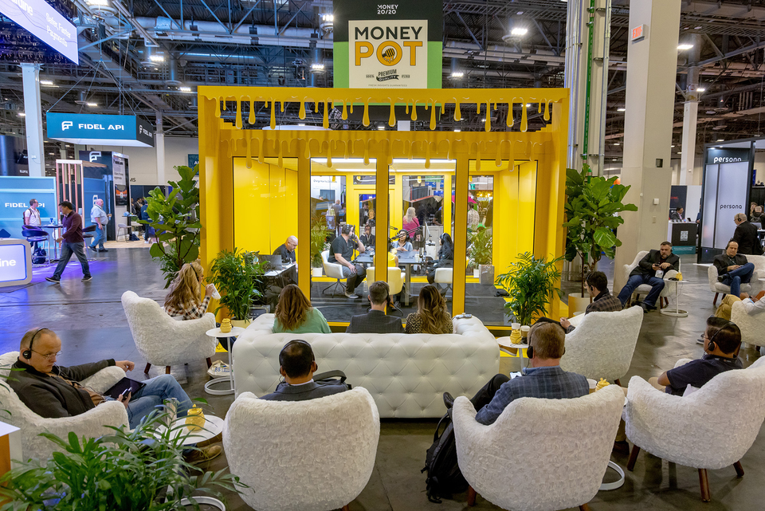
Podcasting
...and Wifi

Slide 17
YOLO

Slide 18
Lead Times
Then
Now
RFP
RFP
Event
RFP
Planning
Event

Slide 19
Current Lead Times
41%
34%
% OF PLANNERS
JULY/AUGUST 2024
SOURCE: NORTHSTAR

Slide 20


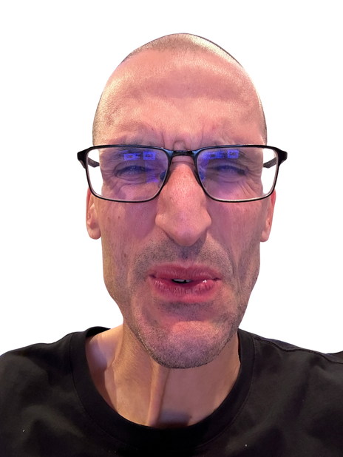
ARE ATTENDEES FOR YOUR MAIN EVENT
47.8%
6.8%
REGISTERING LATE
32.7%
REGISTERING AT
THE SAME TIME
12.7%
REGISTERING THE WEEK BEFORE THE EVENT

Slide 21

Early birds don’t work as they used to.
Top speaker
announcements
Price
increase cliffs
Progress bar with available tickets

Slide 22
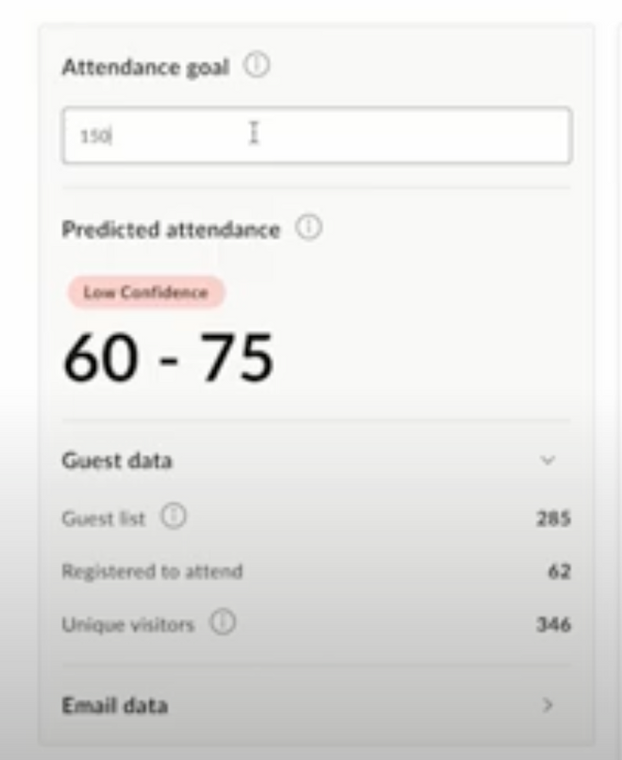


PREDICTING ATTENDANCE

Slide 23
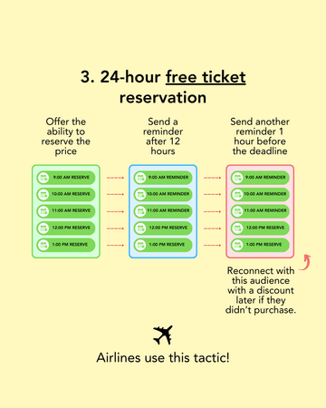
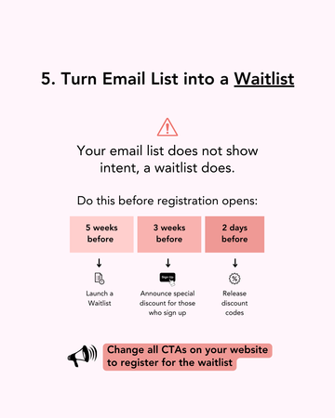
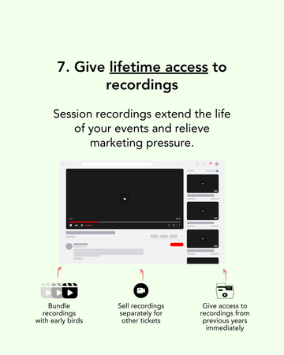
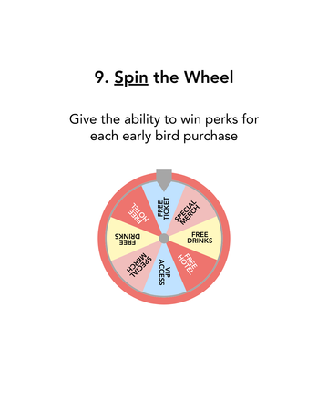
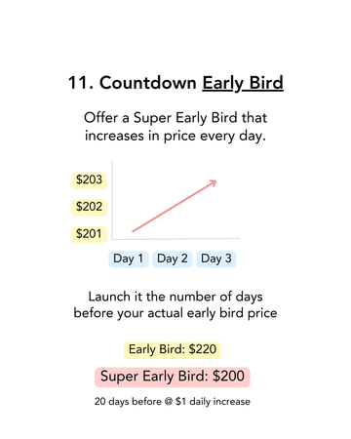
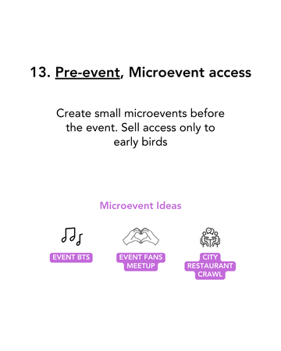
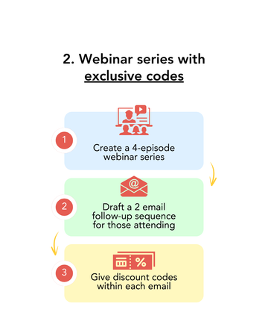
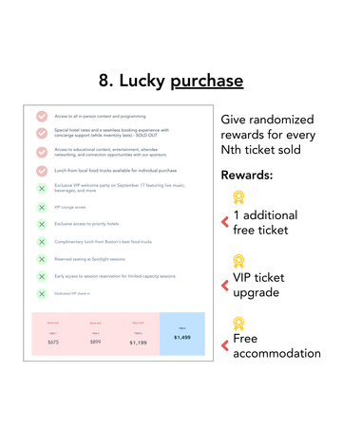
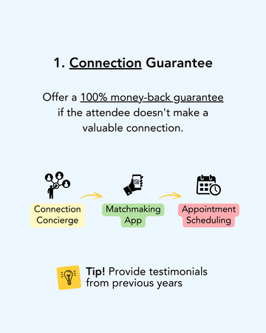
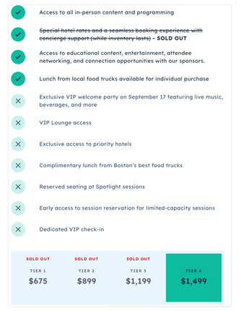
14 Tactics to Fight Late Registrations

Slide 24
A NEW BREED OF VENUES

Slide 25





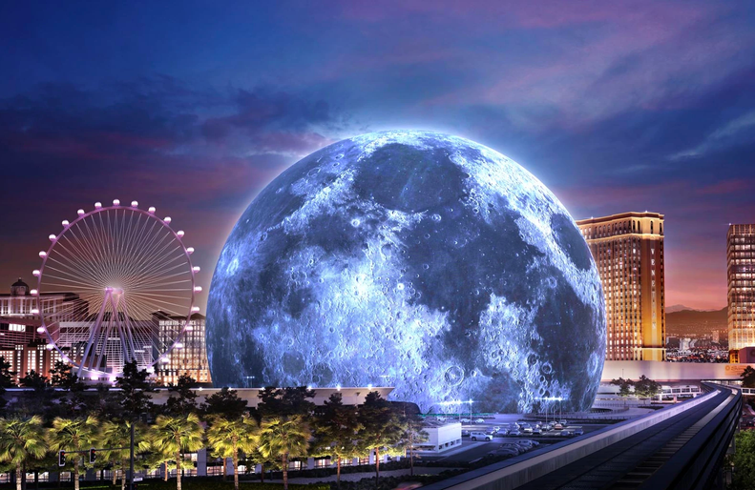


HOW THE SPHERE WILL CHANGE VENUES FOREVER
IMMERSIVENESS
MARKETING
You feel like you are in a Disney attraction. You are in a different, futuristic world.
You don’t need marketing if you run an event at the Sphere. Everybody wants to go.
VIRALITY
EVENT DESIGN
The venue is 100% of your soical media plan
The venue designs 50% of your event. You will need to unleash creativity, but the venue does help.
CUSTOMIZATION
BRANDING
The screen lets you customize the experience and change the experience with each piece of content.
The branding capabilities are from another world and worth $450K per day.

Slide 26
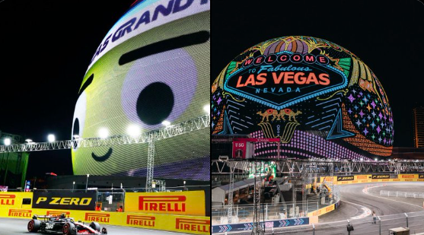
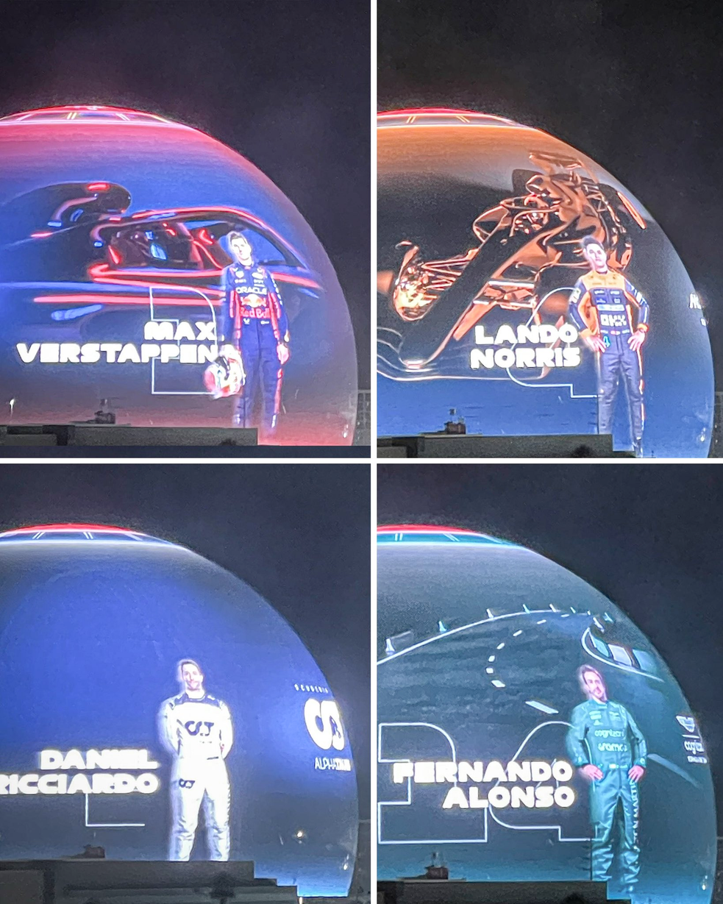
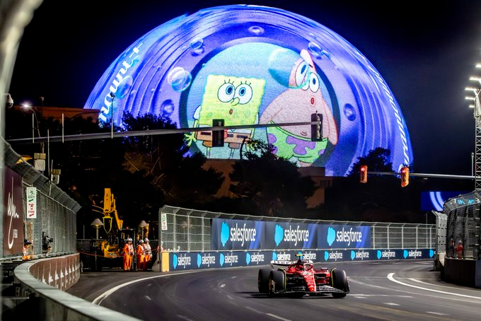

Slide 27
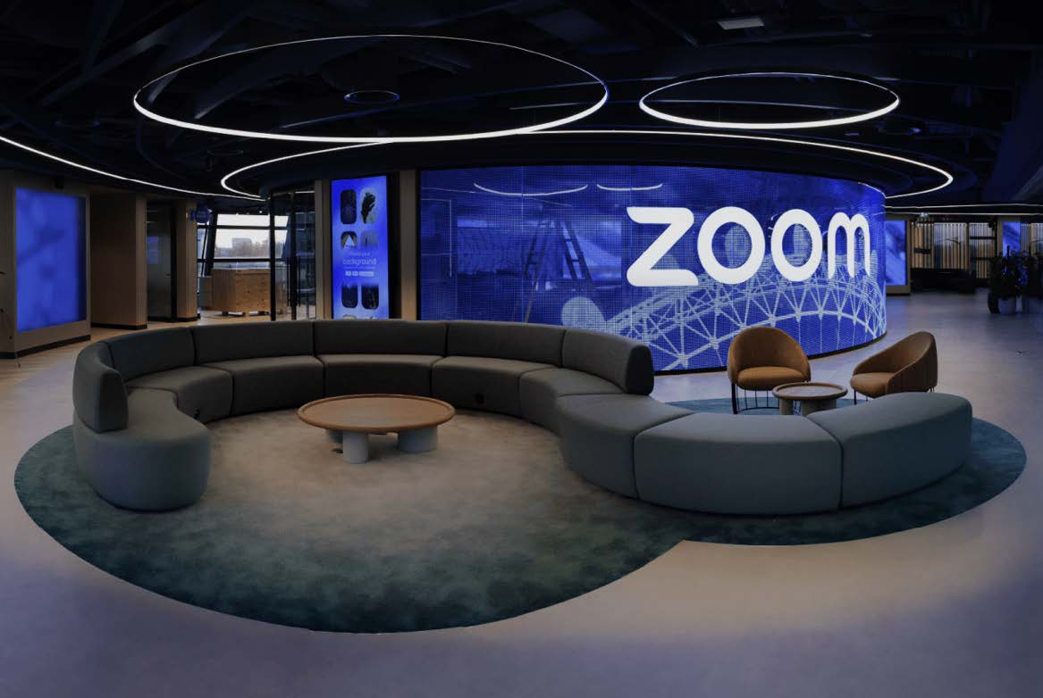

Slide 28
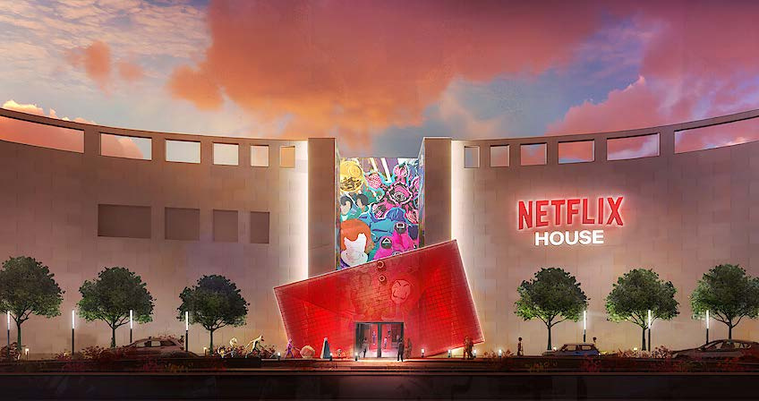

Slide 29

TECHNOLOGY IS IMPACTING VENUE SELECTION
More planners say that the ability to run tech-rich events impacts their destination – selection.

Slide 30
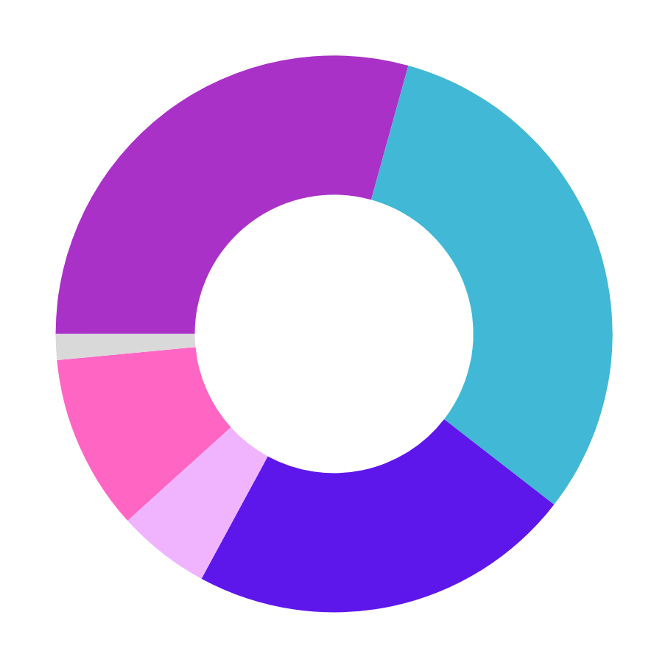

HOW IS BUSINESS LOOKING?
WHAT IS YOUR BIGGEST COST IN 2024?
31.2%
10.2%
VENUE
STAFFING
29.3%
5.4%
FOOD AND BEVERAGE
SOFTWARE
22.4%
1.5%
AV
SPEAKERS

Slide 31
IN HOUSE
VS EXTERNAL

Slide 32
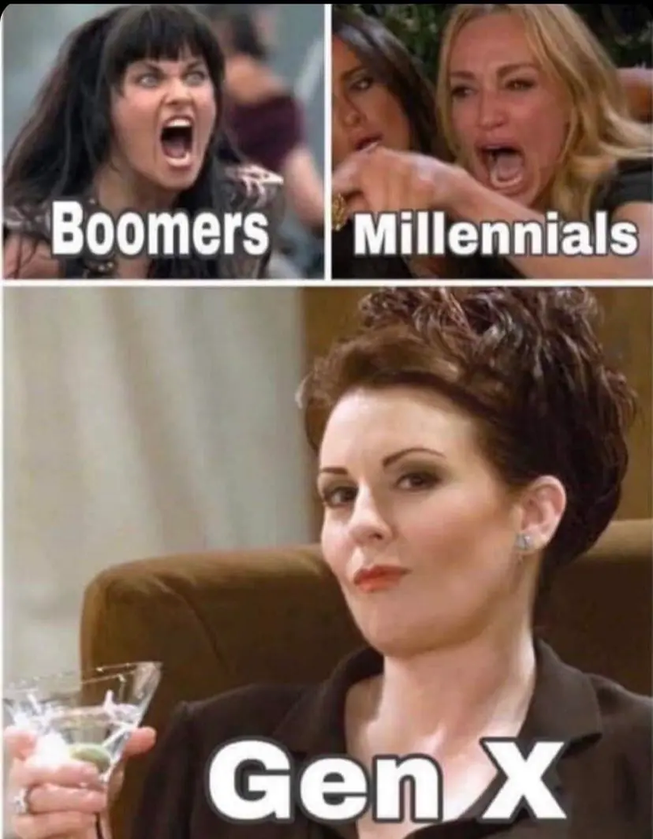


The
Millennials Takeover

Slide 33





Short attention spans are ruling the industry
EVENTS FOR SHORT ATTENTION SPANS
vs
SHORT ATTENTION
SPAN
TRADITIONAL
Event Planning
60 Minute session
Long Reg Form
Sales Pitches
Moment Planning
30-minute session
Name, Email, and Payment
Activations

Slide 34
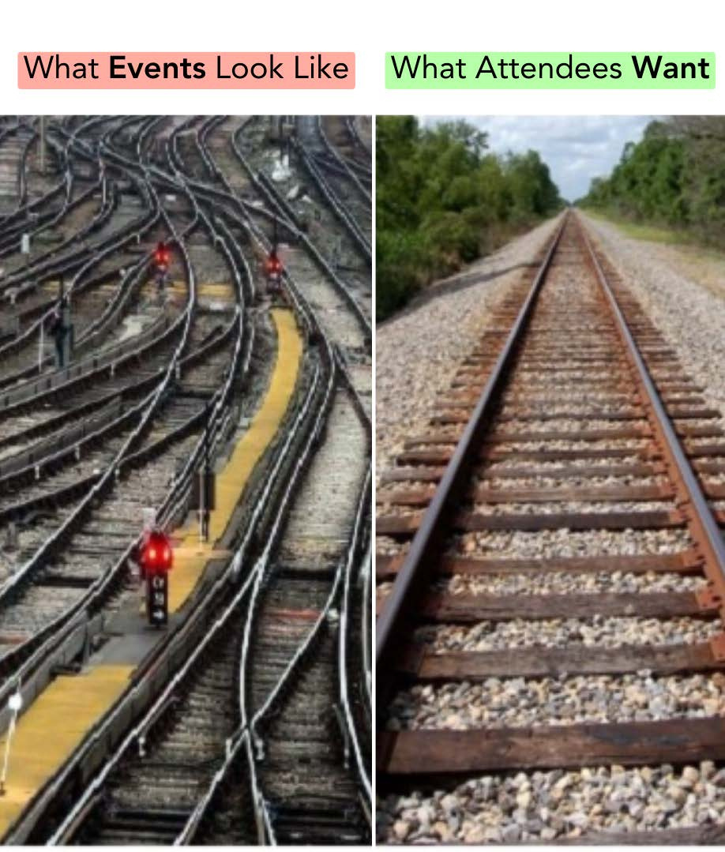
WHAT EVENTS
LOOKS LIKE
WHAT ATTENDEES
WANT

Slide 35
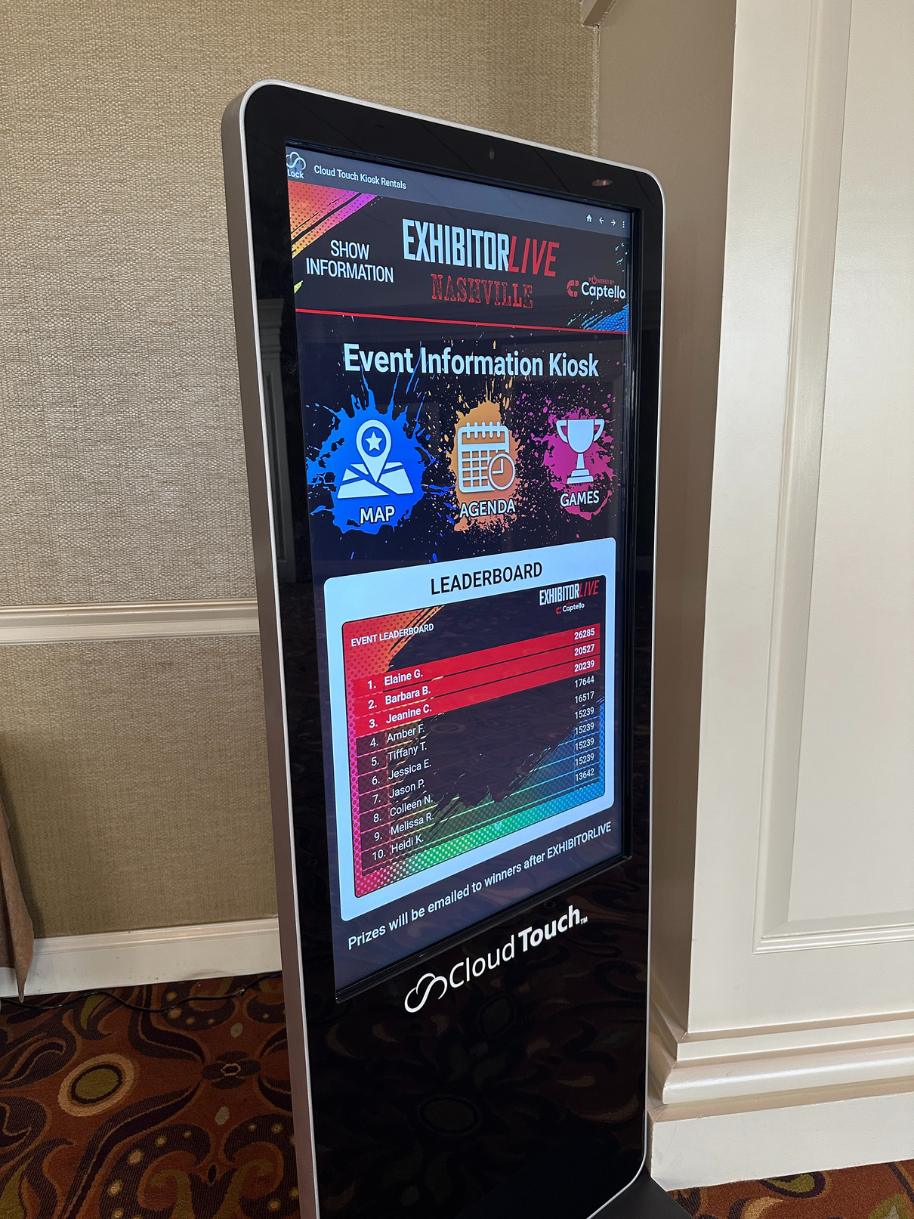
WAYFINDING

Slide 36
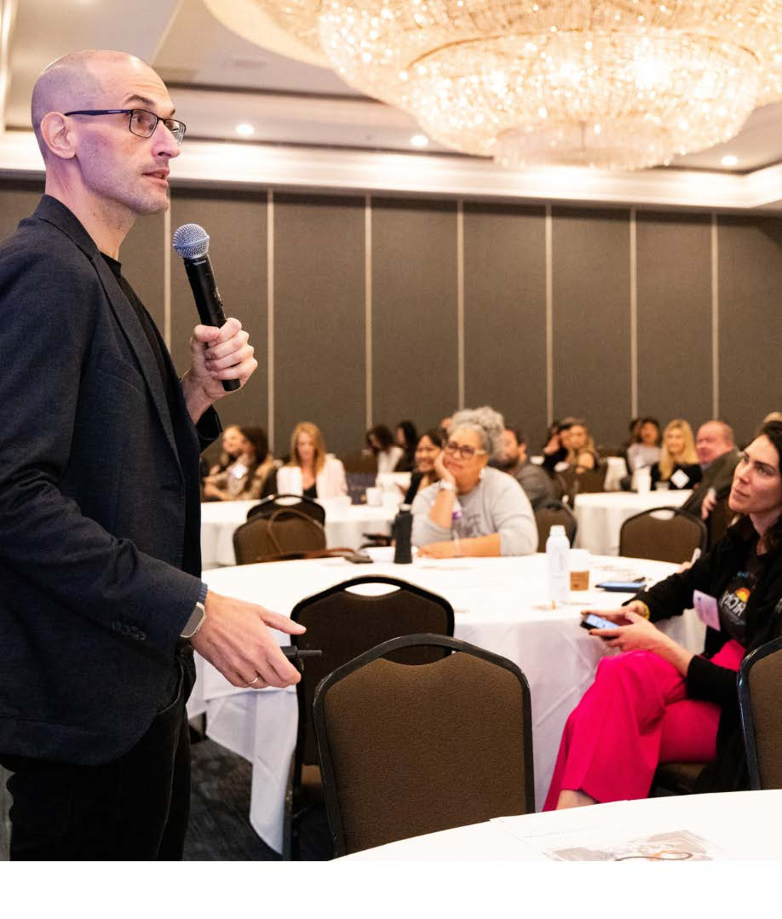
SMALL IS THE NEW BIG

Slide 37
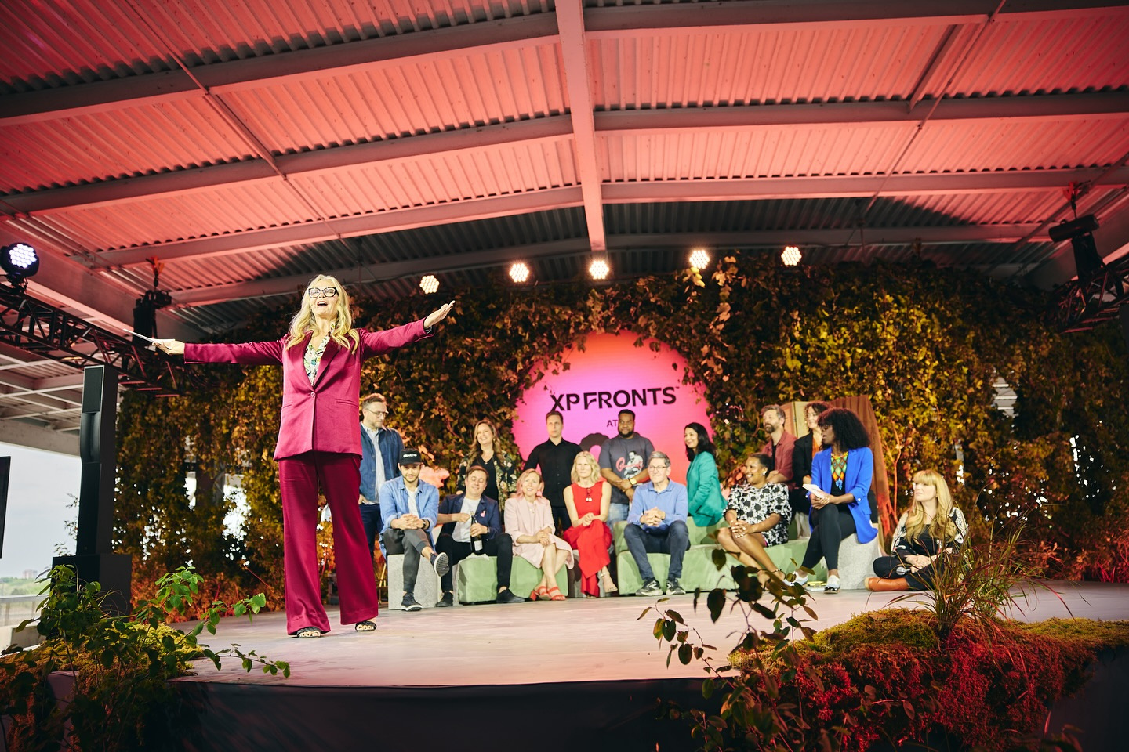
XP FRONTS @C2

Slide 38






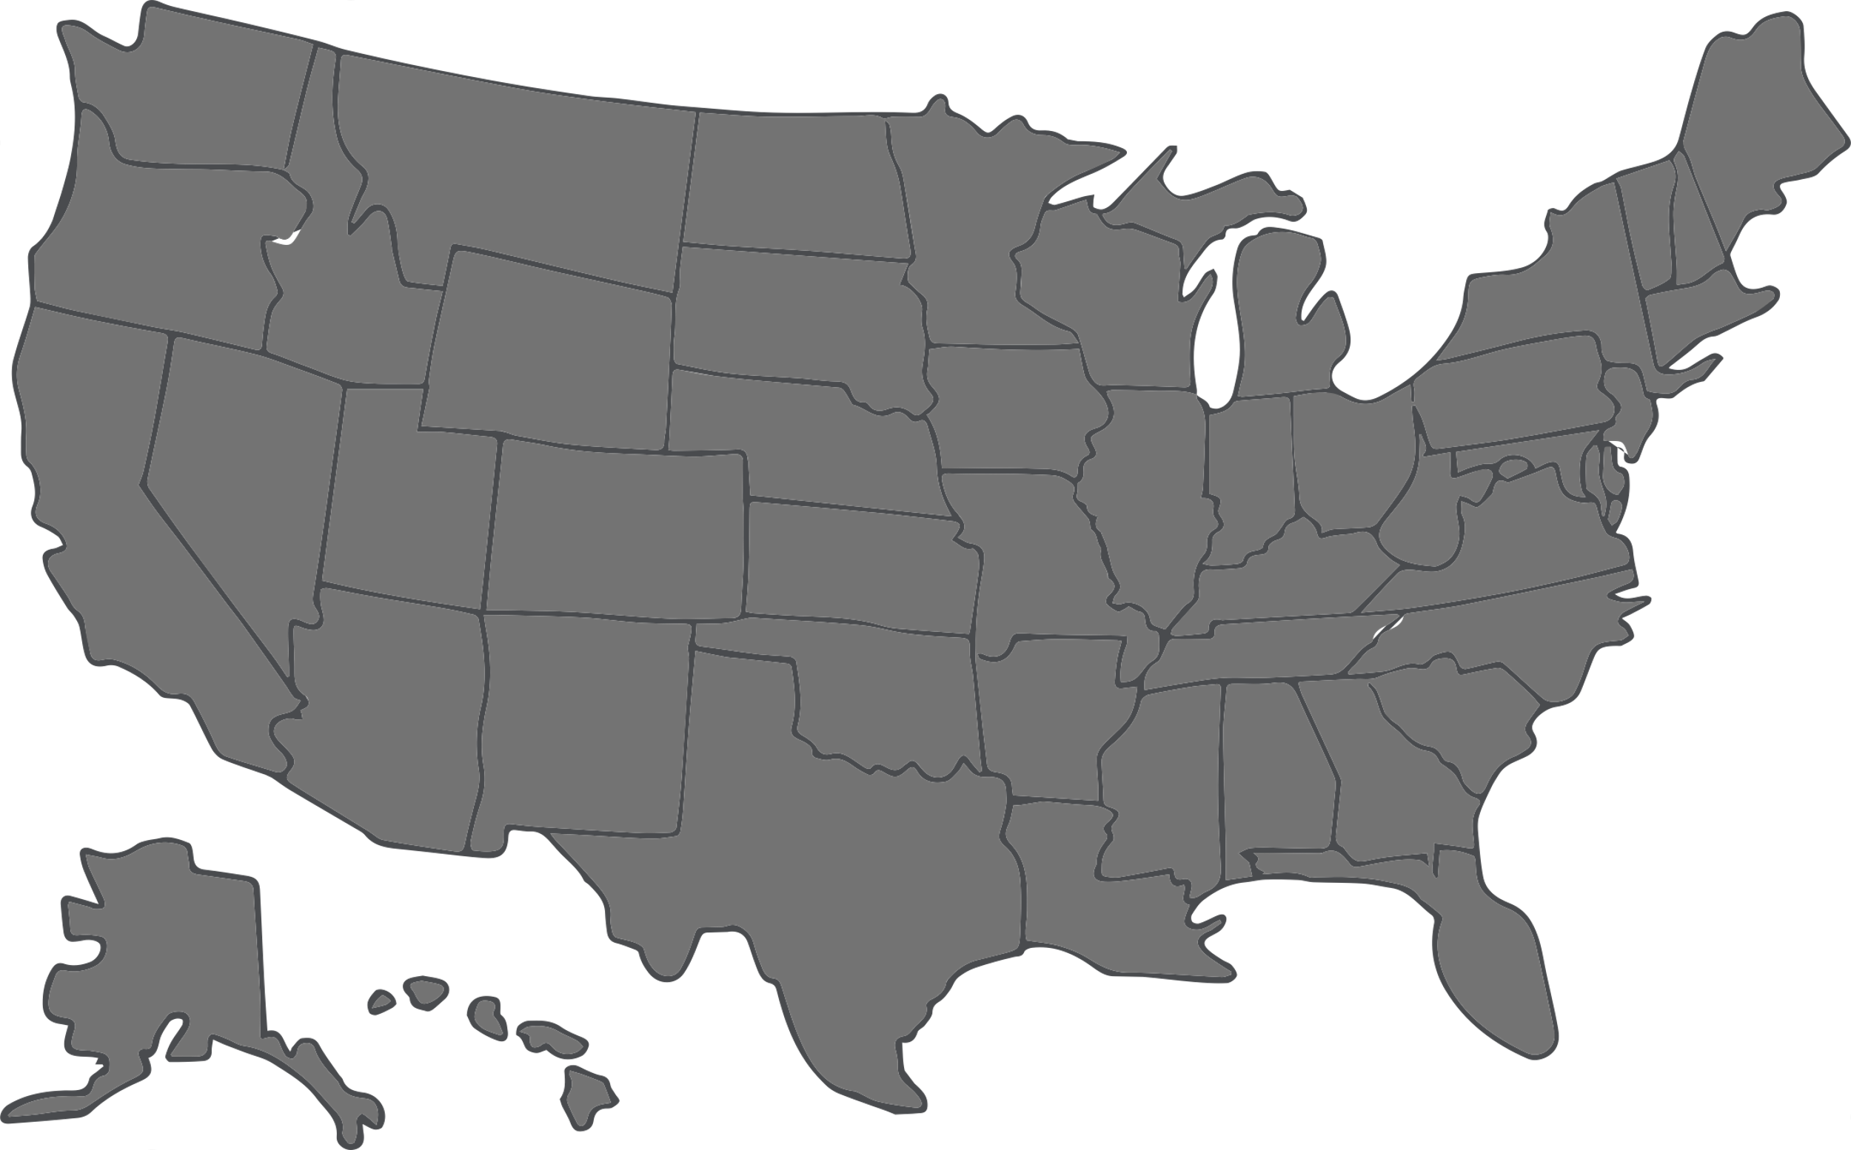



A guide to Microevents
Venue
The Event
Type
Choose unique venues
Have an MC
Reserve quiet space in busy venues
1 speaker or 1 panel
>
Identity eg Young Eventprofs
Keep participants low
>
Interest eg Instagram dinner
Invitation
Offer food and drinks
>
Activity eg Hiking
Make introductions
>
Status eg VIP event
Call 1:1 if exclusive
Rotate seating
Offer goody bags and perks
>
Topic eg Events track during a business show
Logistics
Assign a concierge to handle registrations and logistics
Media
$
How to do Microevents
Clear and easy KBYG
Capture video and pictures
Larger Event
After the Event
Roadshow
Reach your prospects where they are
Hosted buyer
  Invite prospective buyers by application
Have the microevent option in your larger event registration
Send questionnaires
Send exclusive discount offers
Create a microevent space
Share the slides
Content Recording Sessions
Live Podcasts or Video recording
Invite exhibitors to offer microevents as an activation
Share the video recap and pictures
Move the audience to an online group

Slide 39



Why are events becoming so important to do business?

Slide 40
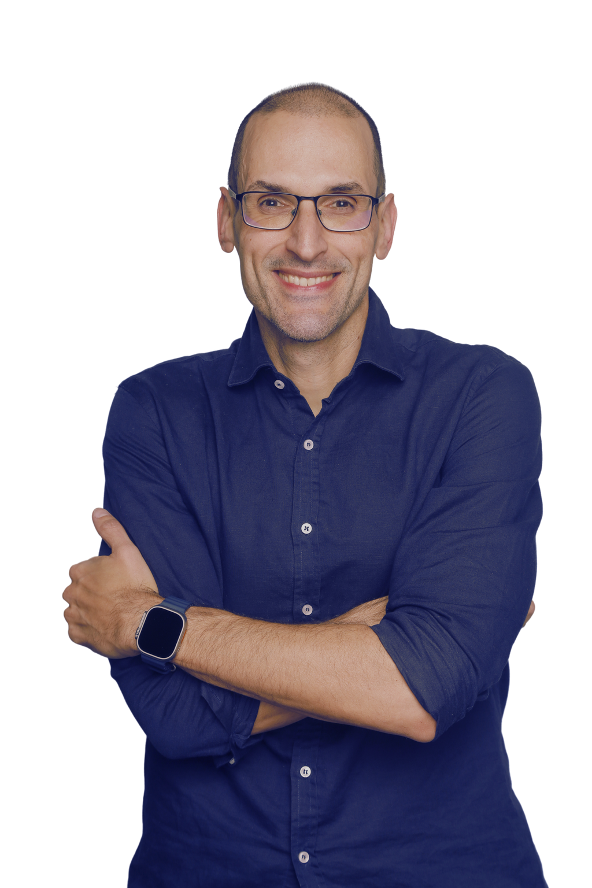
Julius Solaris
+ Follow
Self Admittedly Obsessed with Events
You can’t FAKE events

Slide 41
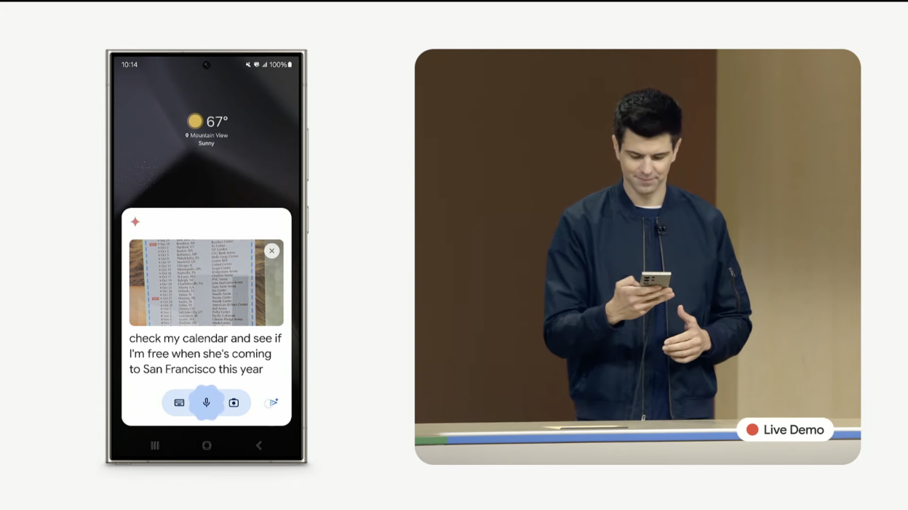
That Moment

Slide 42
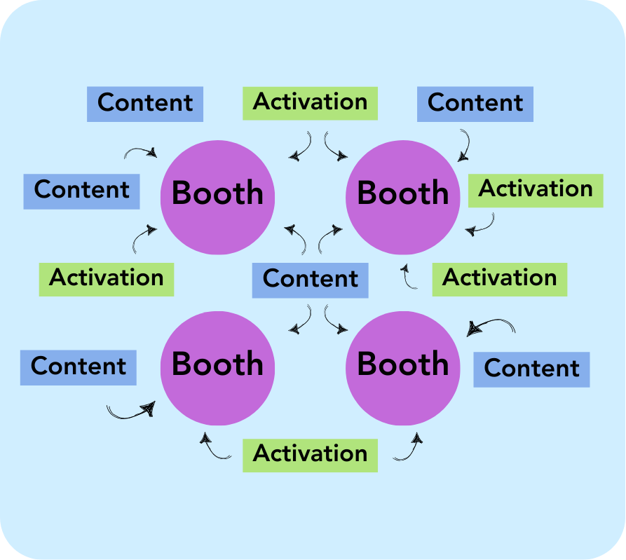
The
High Street Show Floor

Slide 43
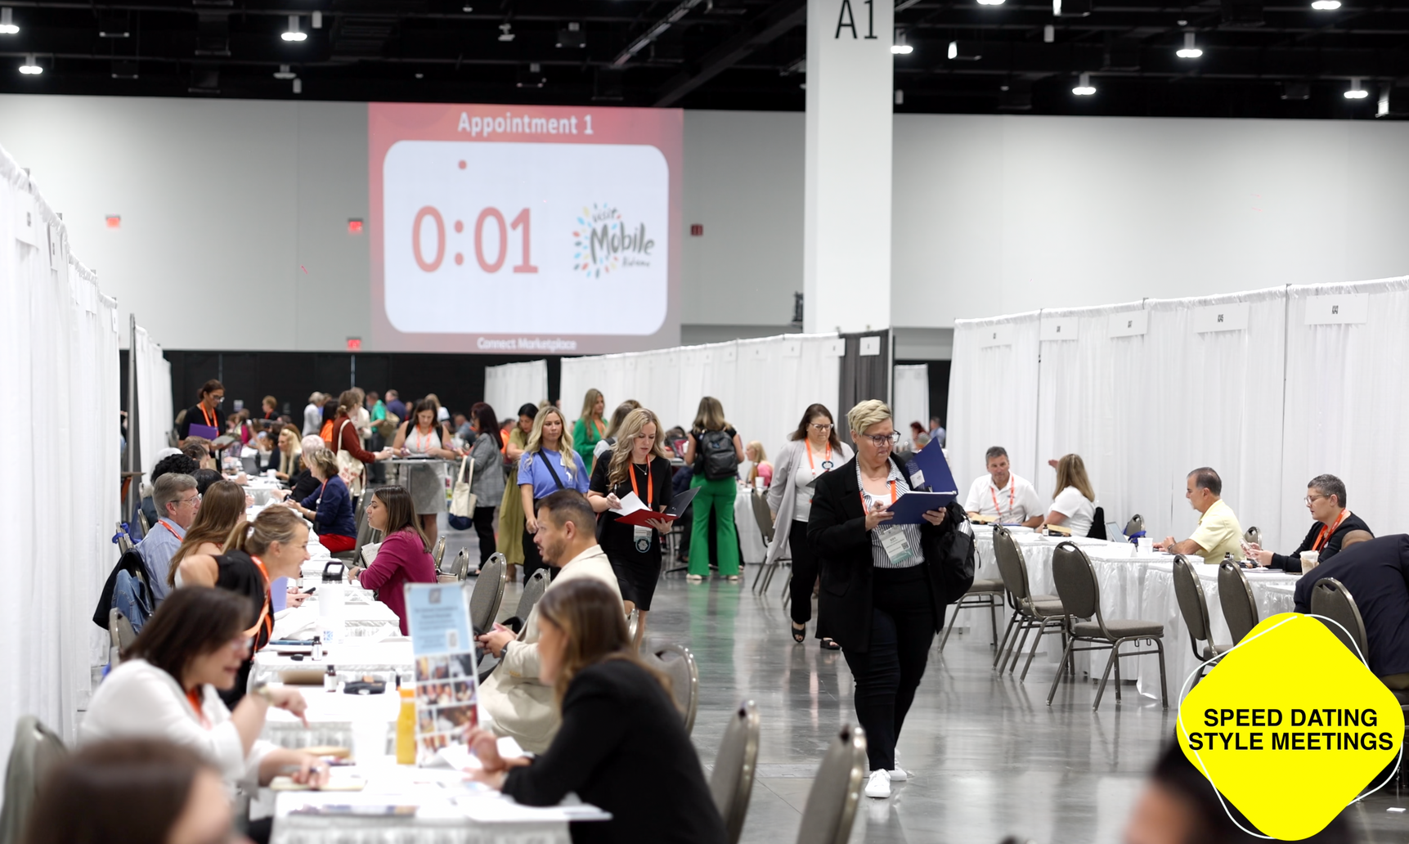
This is Business

Slide 44
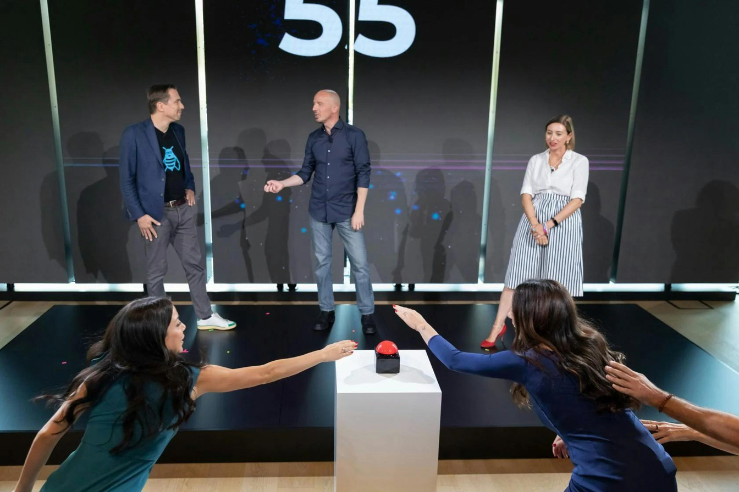
This is Business

Slide 45
↑MOMENT PLANNING
↓EVENT PLANNING

Slide 46
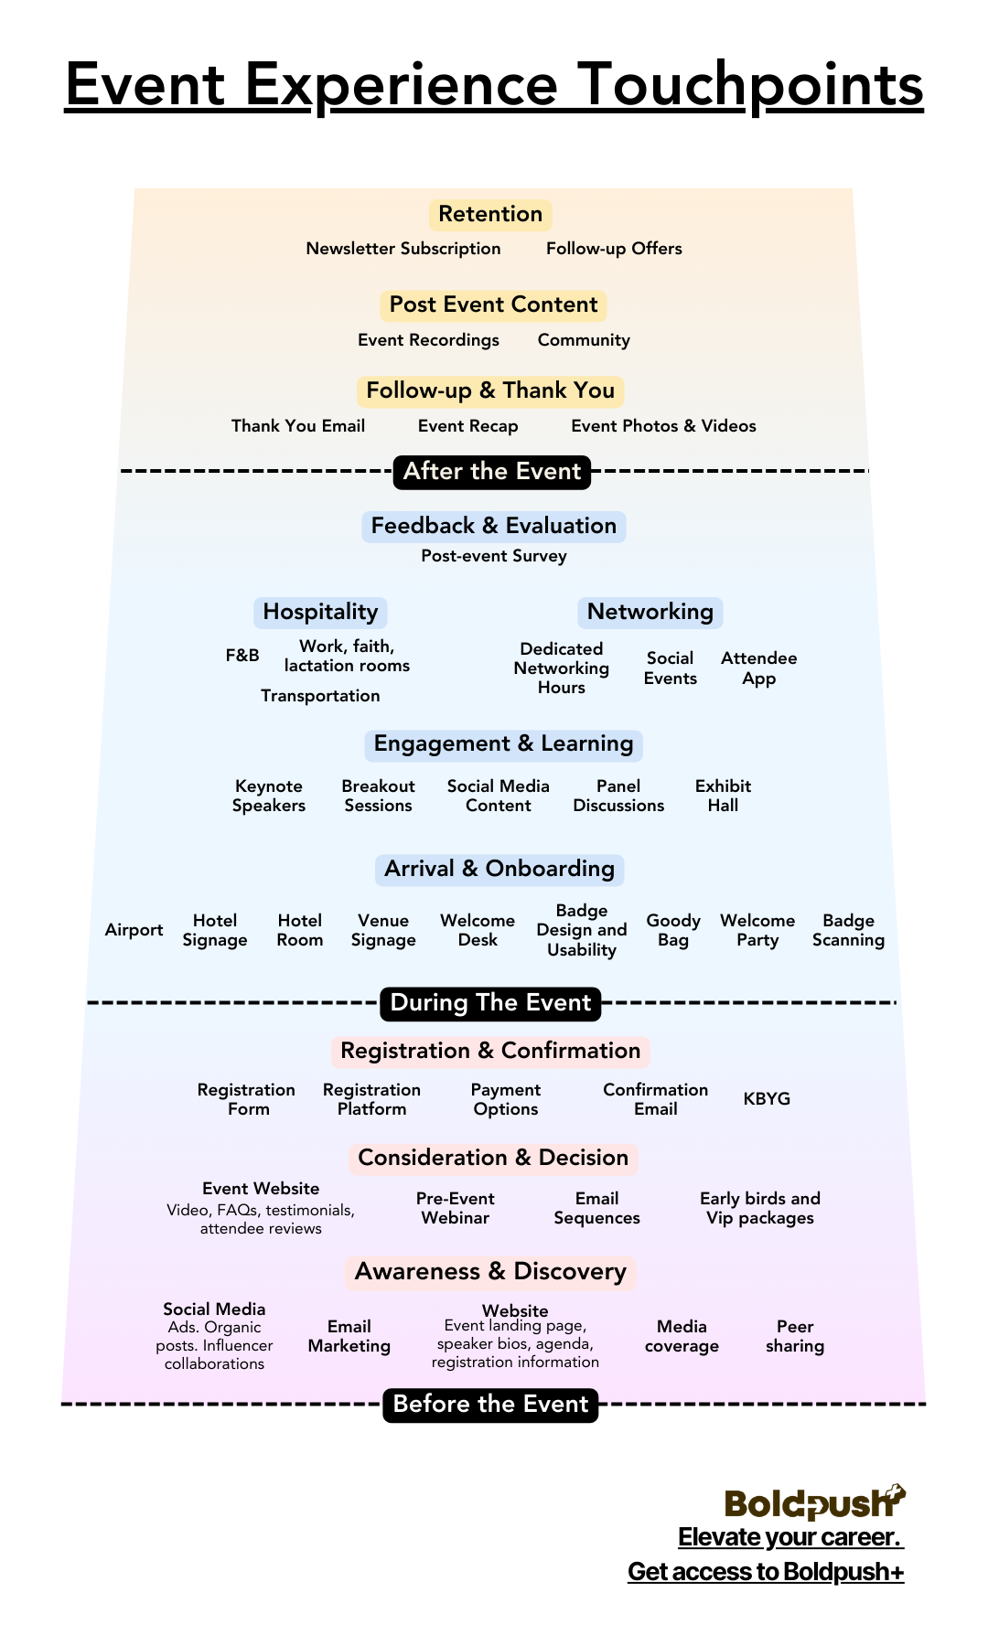
Experience Map

Slide 47

ConnectionMap
Post-event Surveys
Alumni network
Online Community
Virtual Follow-up Sessions
Content library
Reunion Meetups
Social media comments and interaction
reply to everyone still
engaging
After the Event
Interactive Check-in and Welcome
Networking objective based badges and ribbons
First timers orientation
Group icebreakers
Braindates
add music and refreshments
Networking ambassador welcome
Lunch and learn sessions opportunities
Attendees’ social posts highlights
Social wall
Moderated Interactive workshops
Speed networking
Buyer/
supplier meetings
Scavenger hunt
Themed meal experiences
Identity, job role or interest-based microevents
Speaker meet-and-greets
Designed serendipity spaces
White space lounges
Group Wellness Activities
Seated networking with table swaps
Closing Party
During The Event
Networking questionnaire and objectives
Event App
Pre-event Online Community/Slack/Group messaging
Hashtag engagement and replies
Allows early networking
Know Before You go Webinar
Personalized Agenda Creation and sessions saves
Meetings booking and matchmaking
Networking concierge intro
Airport reception
Before the Event

Slide 48


The event starts before the event starts.
Website
Airport
Hotel

Slide 49
REGISTRATION
IN 2025

Slide 50
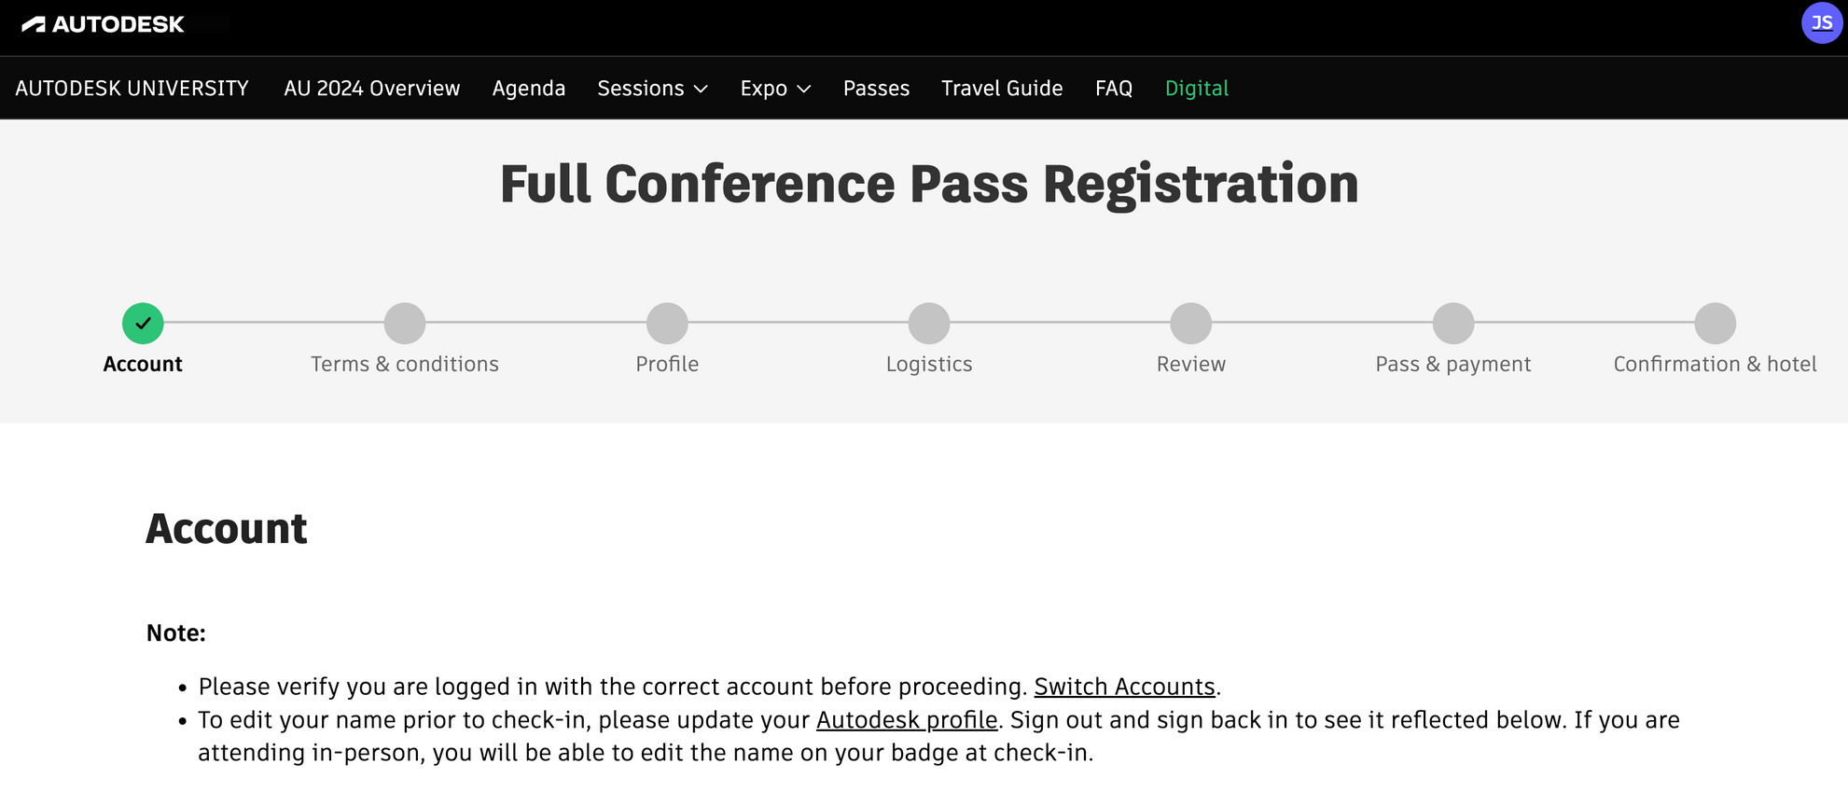

Slide 51
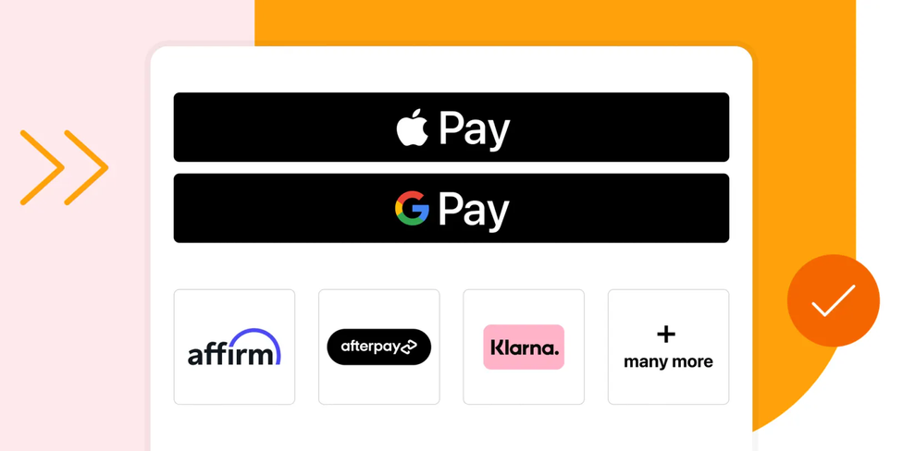
THE NEW REGISTRATION FORM
NAME
EMAI﻿L
PAYMENT

Slide 52
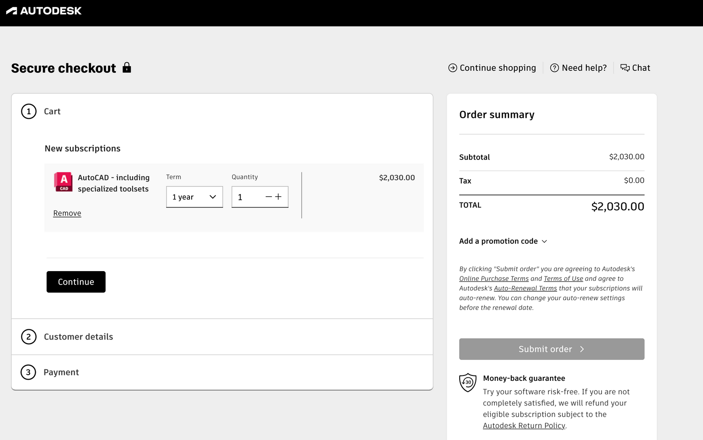

Slide 53
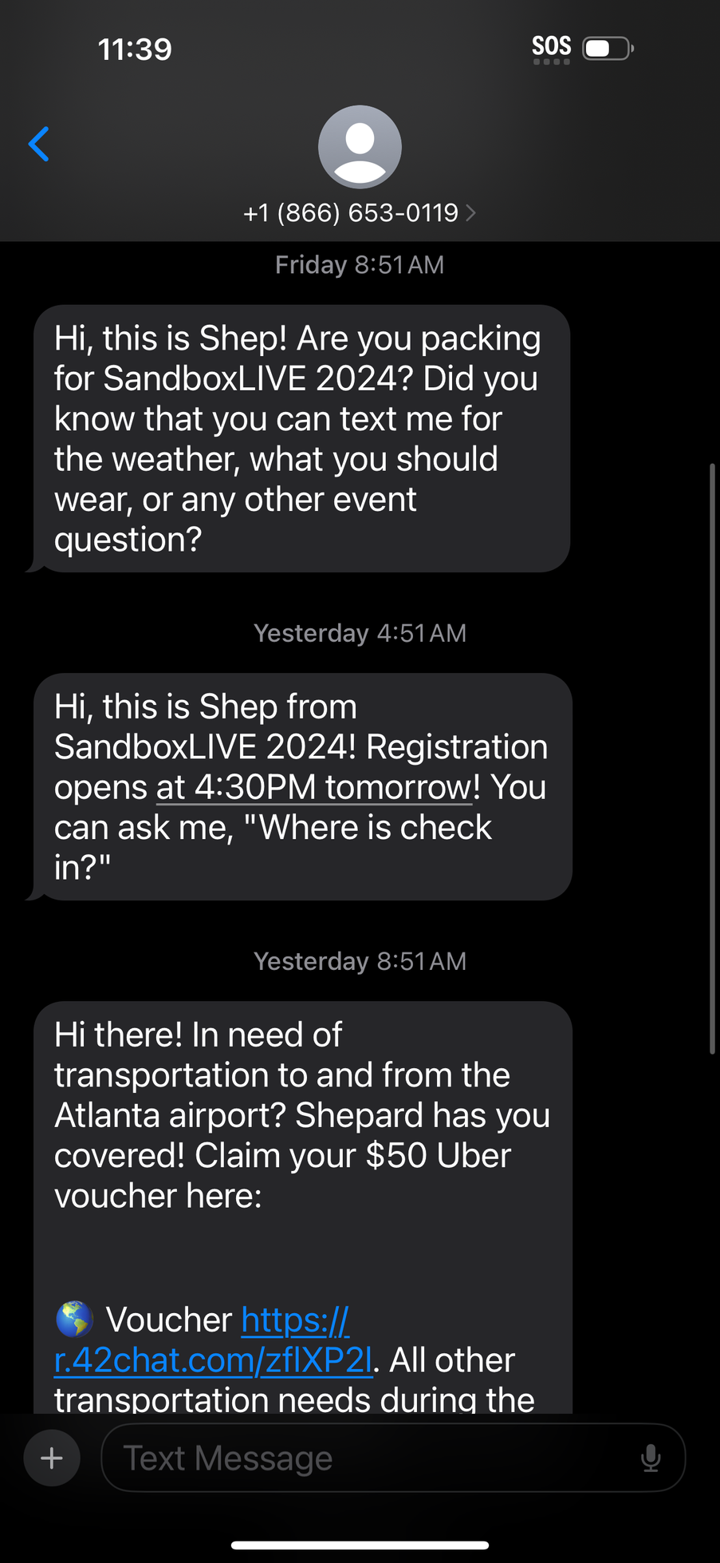
THE WELCOME MATTERS

Slide 54
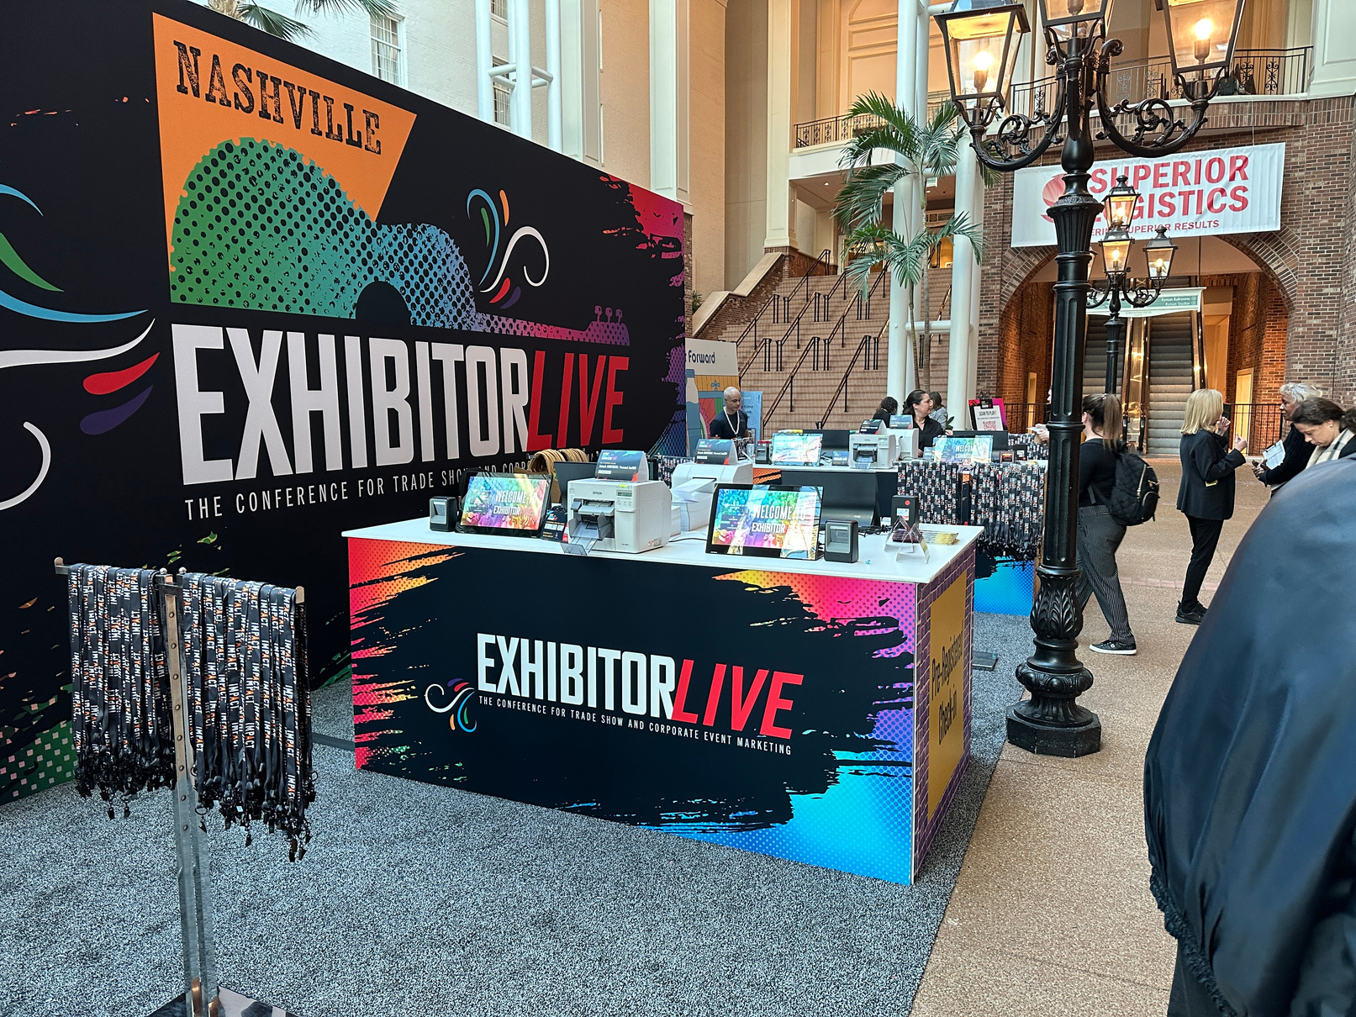
THE WELCOME MATTERS

Slide 55
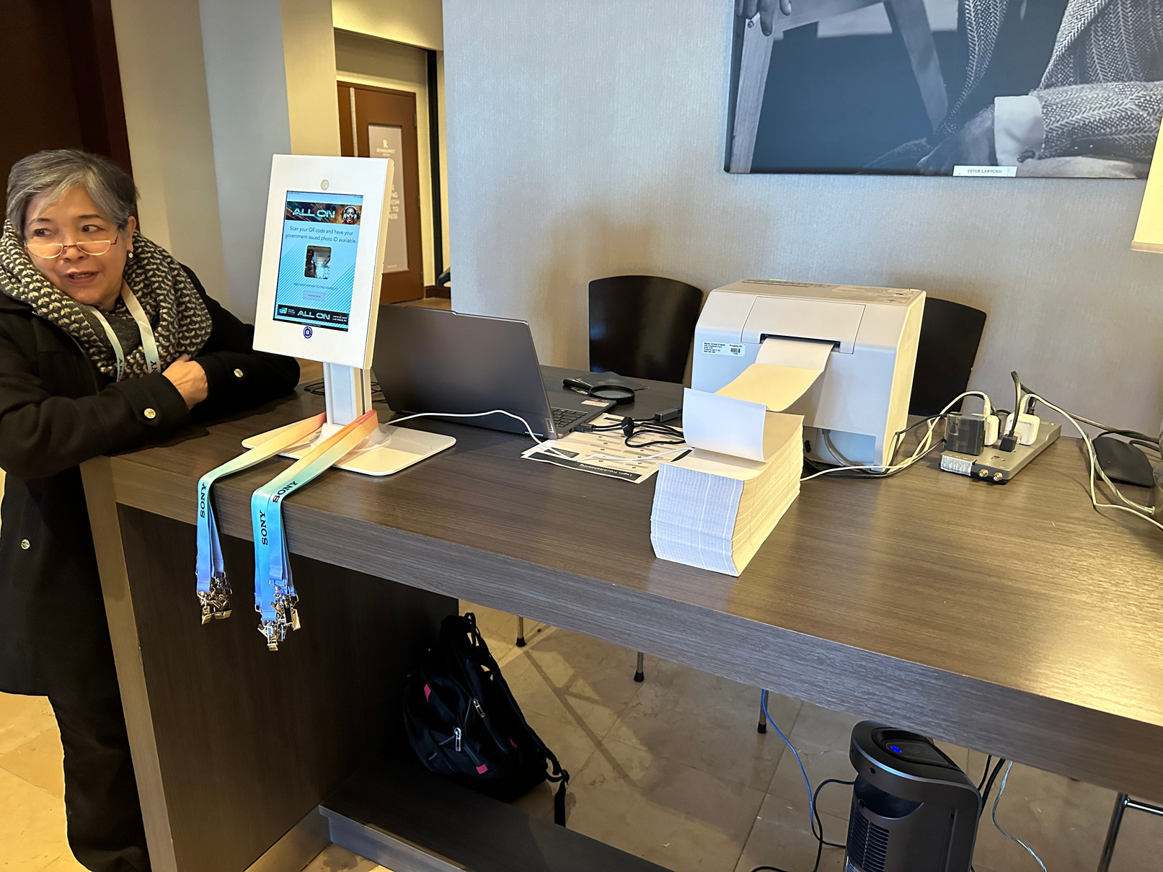
THE WELCOME MATTERS

Slide 56
Brand Touchpoints
EVENT WEBSITE
ONLINE REGISTRATION SYSTEM
EMAIL CAMPAIGNS
Registration confirmation
EVENT REMINDERS
Implement consistent brand color scheme and typography across all pages
Integrate brand logo and tagline into each step of registration
Use branded email templates with consistent header and footer design
Include a branded confirmation number or QR code design
Use brand voice consistently in all reminder copy and messaging
KNOW BEFORE YOU GO
SOCIAL MEDIA PROFILES AND POSTS
ONLINE ADS
Webinars or virtual info sessions
PROMOTIONAL VIDEOS
PRE-EVENT
Create an infographic using brand colors and iconography style
Maintain consistent brand imagery and hashtags across all platforms
Ensure all ad creatives align with brand guidelines and event theme
Use branded virtual backgrounds and lower thirds graphics
Open and close with consistent branded animation or bumper
VIRTUAL EVENT PLATFORM
PRESS KITS
INFLUENCER PARTNERSHIPS AND PROMOTIONS
Sponsor prospectus
Customize platform interface with brand colors and logo placement
Develop a cohesive visual style for all press materials and fact sheets
Provide clear brand guidelines for influencer content creation
Design a visually stunning document showcasing brand and sponsorship opportunities cohesively - prefer infographic style

Slide 57
Brand Touchpoints
EVENT MOBILE APP
SOCIAL MEDIA WALLS
INTERACTIVE EVENT MAPS
IN-EVENT
DIGITAL
Customize app interface with brand colors, icons, and fonts for seamless experience. Choose White Label.
Design a branded frame or overlay for usergenerated content displays
Create custom map pins and location markers that align with brand style
VENUE EXTERIOR SIGNAGE
ENTRANCE BRANDING
(BANNERS, FLAGS, WELCOME MAT, REGISTRATION DESK)
DIRECTIONAL SIGNAGE AND FLOOR DECALS
Hanging banners and suspended signage
STAGE AND PODIUM BRANDING
Use large-scale brand elements for high visibility and first impressions
Create an immersive brand experience from the moment attendees arrive
Incorporate brand colors and typography into clear, consistent wayfinding system
Utilize vertical space to reinforce brand presence throughout the venue
Design a cohesive look that enhances speakers while prominently featuring brand
BACKDROP FOR SPEAKERS AND PANELS
SEATING AREA BRANDING
BRANDED PHOTO OPPORTUNITIES AND BACKDROPS
Restroom branding
ELEVATOR WRAPS
IN-EVENT
Prefer LED screens with video interstitials and event branding
Subtly incorporate brand elements into comfortable, functional seating arrangements
Design shareable moments that attendees will want to post online
Use unexpected branding moments to surprise and delight attendees
Transform transitional spaces into brand immersion experience
LANYARDS AND NAME BADGES
EVENT PROGRAMS AND SCHEDULES (PRINTED)
CHARGING STATIONS
Create functional, attractive credentials that double as wearable branding
Design an easy-to-use guide that serves as a branded keepsake
Transform a necessity into a branded amenity that attendees appreciate

Slide 58
Brand Touchpoints
FOLLOW-UP EMAILS
EVENT HIGHLIGHTS
POST-EVENT SURVEYS
Event recap videos
CONTENT LIBRARY
POST-EVENT
Maintain event branding while transitioning to next steps or future events
Curate branded visual summaries that reinforce key moments and messages
Create a branded survey experience that encourages thoughtful feedback
Produce polished videos with branded intros, lower thirds, and transitions, showcase content produced
Organize materials in a branded, user-friendly digital archive

Slide 59
NOSTALGIA IS THE NEW BLACK

Slide 60
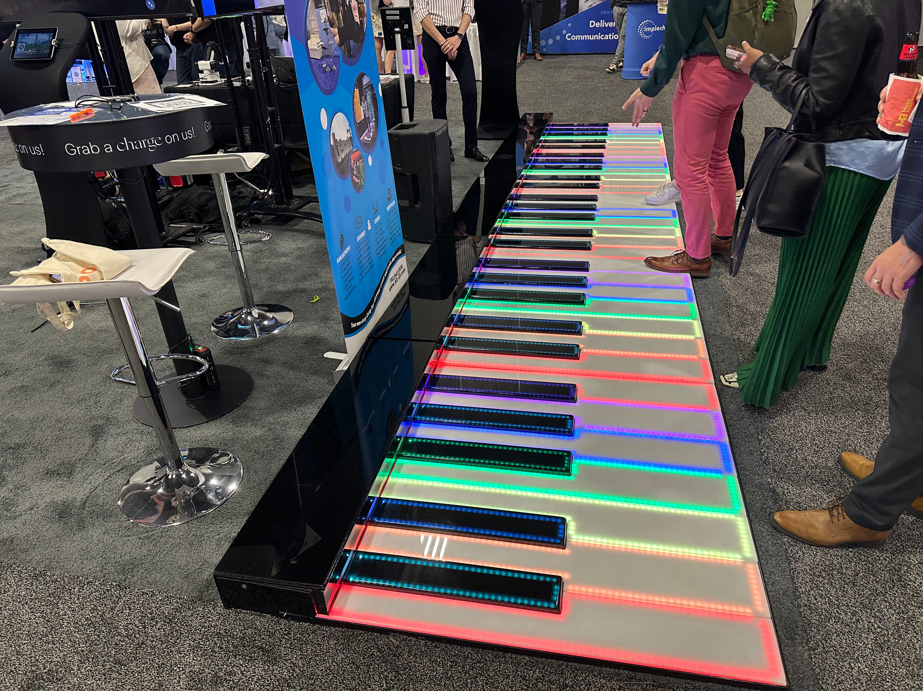
NOSTALGIA IS THE NEW BLACK

Slide 61
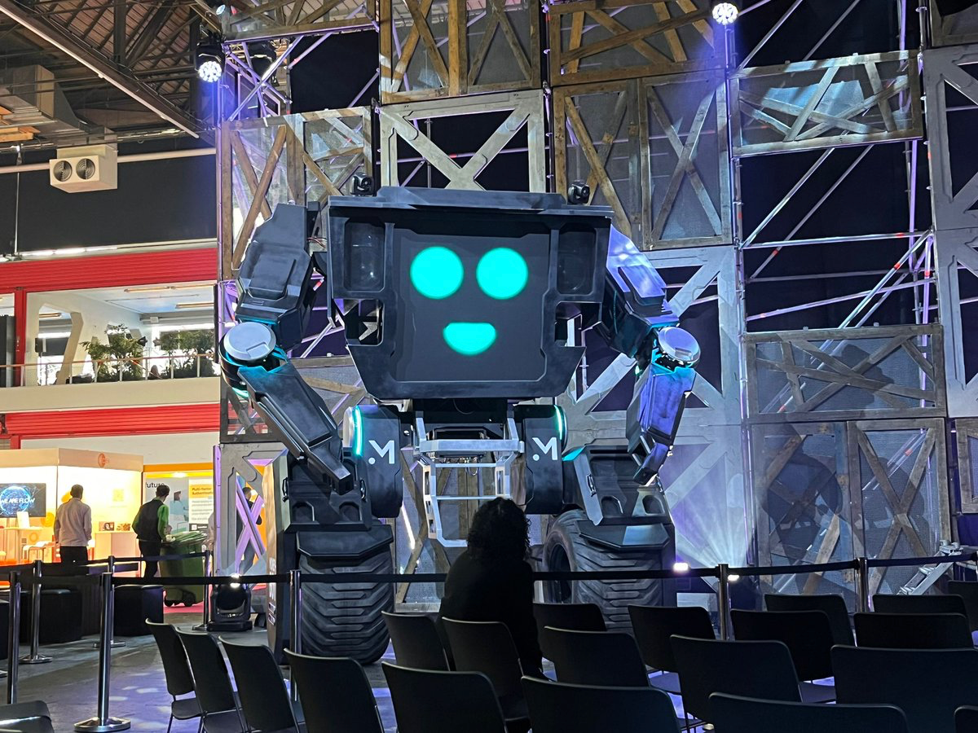
NOSTALGIA IS THE NEW BLACK

Slide 62
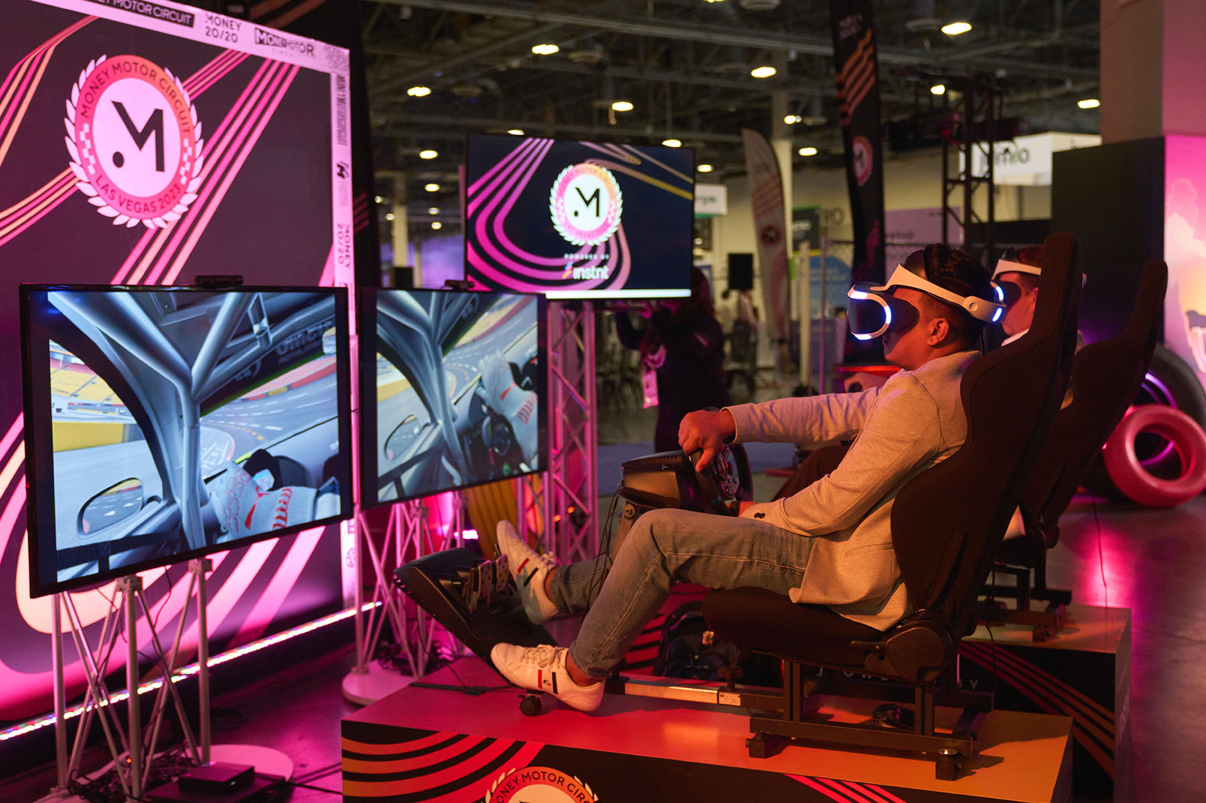
NOSTALGIA IS THE NEW BLACK

Slide 63
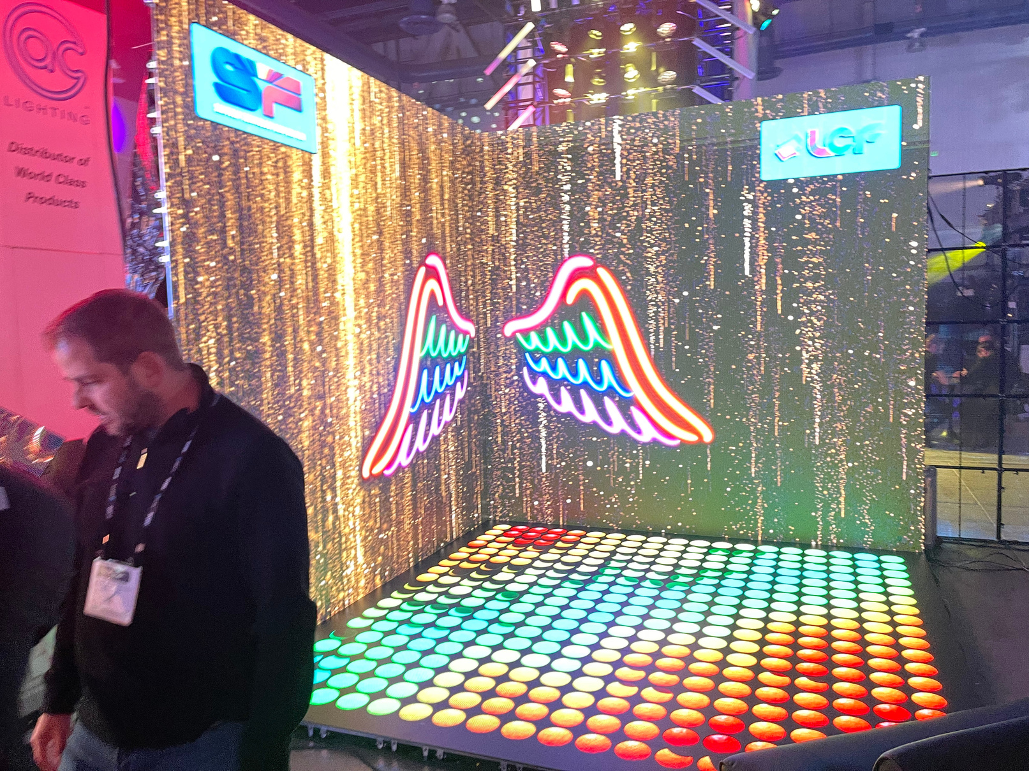
V
NOSTALGIA IS THE NEW BLACK

Slide 64
LET’S TALK
TECH

Slide 65
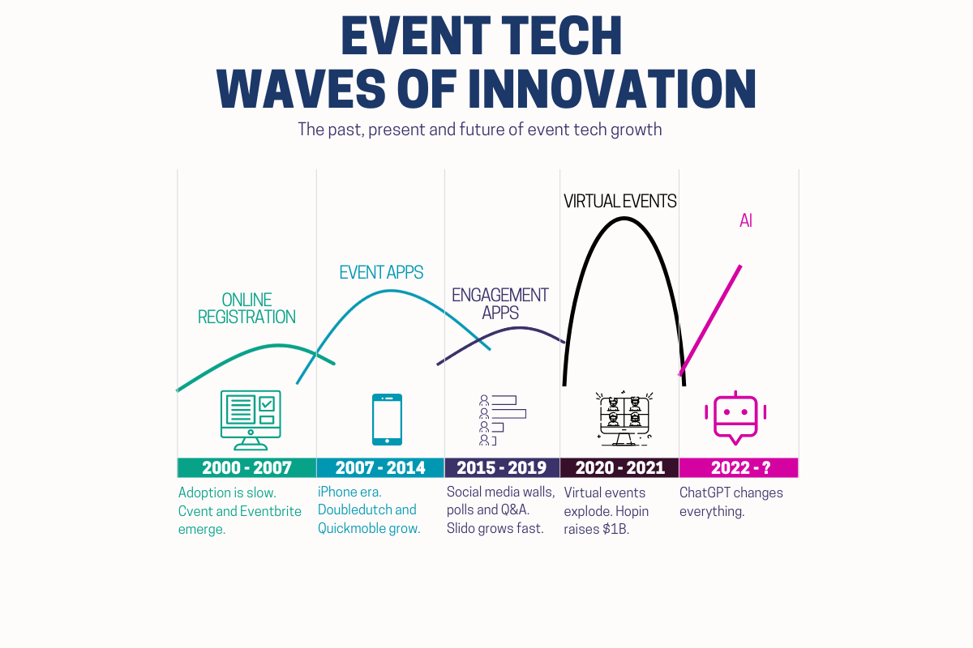

Slide 66

DECLARATIVE AI
TELL YOUR EVENTTECH
SYSTEM WHAT YOU NEED
AND GET IT IN SECONDS
THE FUTURE OF EVENTTECH
Eventtech, as we know it, will be gone. Setting up hypercomplex registration and marketing systems will be voice commanded.

Slide 67

COMPLIANCE AND PRIVACY
of employees upload data to ChatGPT
SOURCE LAYERX

Slide 68






COMPLIANCE AND PRIVACY
Anonymize Data
Uploading sensitive data
can put you at risk
Update Privacy statements
ChatGPT GDPR non-compliance
Watch out for GPT integrations
Copyright is a gray aera

Slide 69

APPROACH
YOUR AI STRATEGY
CONSIDER
What is the quality of output needed?
Will the output be customer-facing?
Will the output impact our product?

Slide 70
APPROACH
YOUR AI STRATEGY
FEEDBACK
VS
DIRECT OUTPUT
SUGGESTIONS
VS
DECISIONS
COPYRIGHT IS A GRAY AERA

Slide 71


Overall smarter answers
Great for high-level data extraction
3.5 - 200k tokens

Slide 72
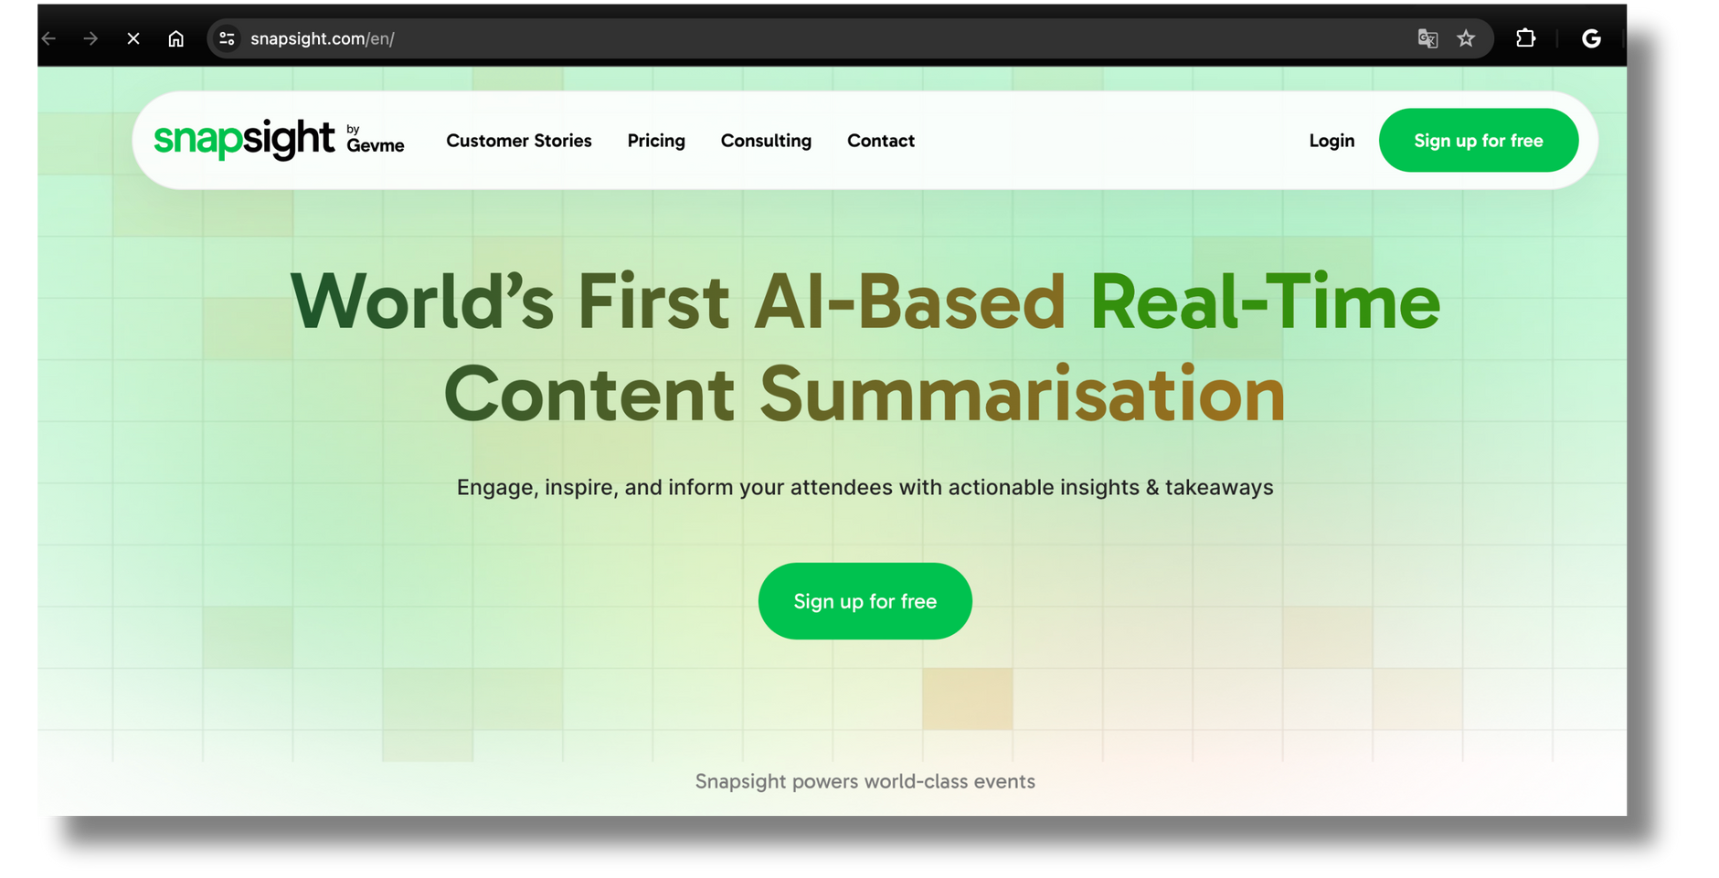
SPEAKER TAKEAWAYS AND SESSION summaries
DEMO

Slide 73



PICTURE RECOGNITION
KAMPFIRE
INEVENT
SPOTMYPHOTOS

Slide 74



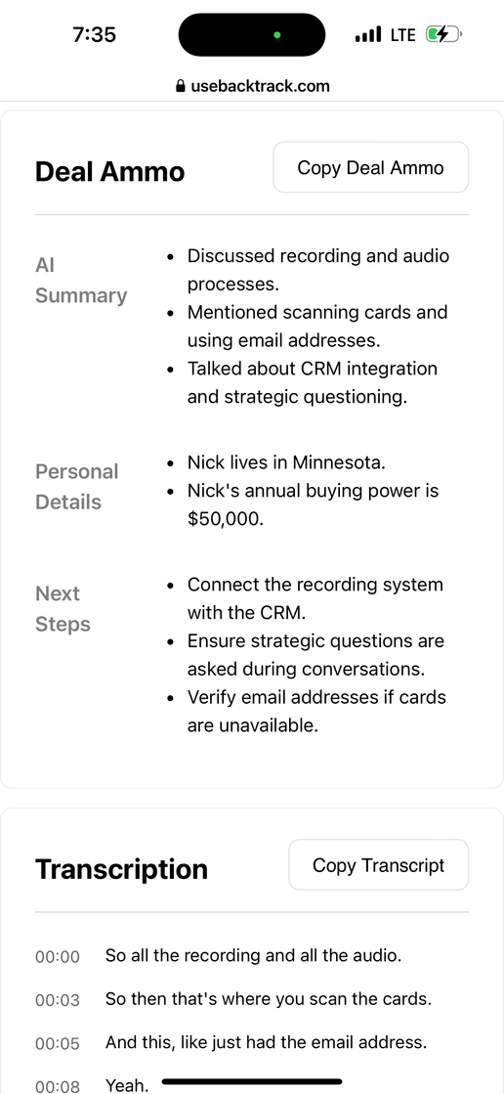
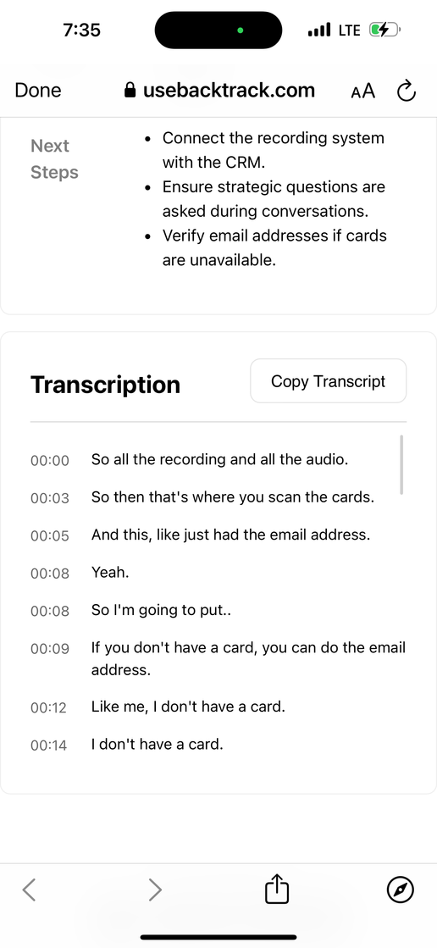
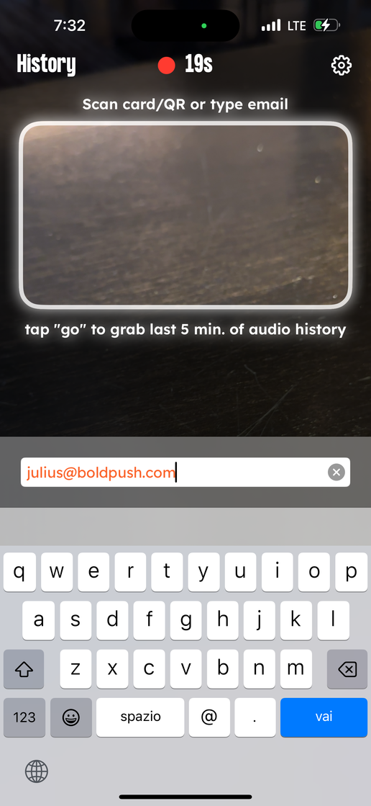
LEAD RETRIEVAL - BACKTRACK
INEVENT

Slide 75




HOW TO USE AI IN
EVENTS
DATA
MARKETING
Upload your registration patterns get insight on your reg strategy
Delegate repetitive tasks
IDEATION
MULTILANGUAGE REPLAYS
Get sponsored sessions and activation ideas
Upload the event sessions and add automated voiceover - Rask.ai
FEEDBACK
PANELS
Ask for copy and marketing feedback
Get question recommendation based on speaker podcasts

Slide 76

WHAT TECH DO YOU SPEND THE MOST ON?
38%
12.7%
REG SOFTWARE
VIRTUAL EVENT
SOFTWARE
16.1%
SPEAKERS/
CONTENT
MANAGEMENT
10.2%
EVENT APP
15.1%
7.8%
MARKETING
SOFTWARE
LEAD RETRIEVAL

Slide 77

DO YOU PLAN
90.6%
50%
48%
VIRTUAL
IN-PERSON
HYBRID

Slide 78

LARGE EVENTS
A
WIDENING
GAP
VIRTUAL
SMALL EVENTS

Slide 79
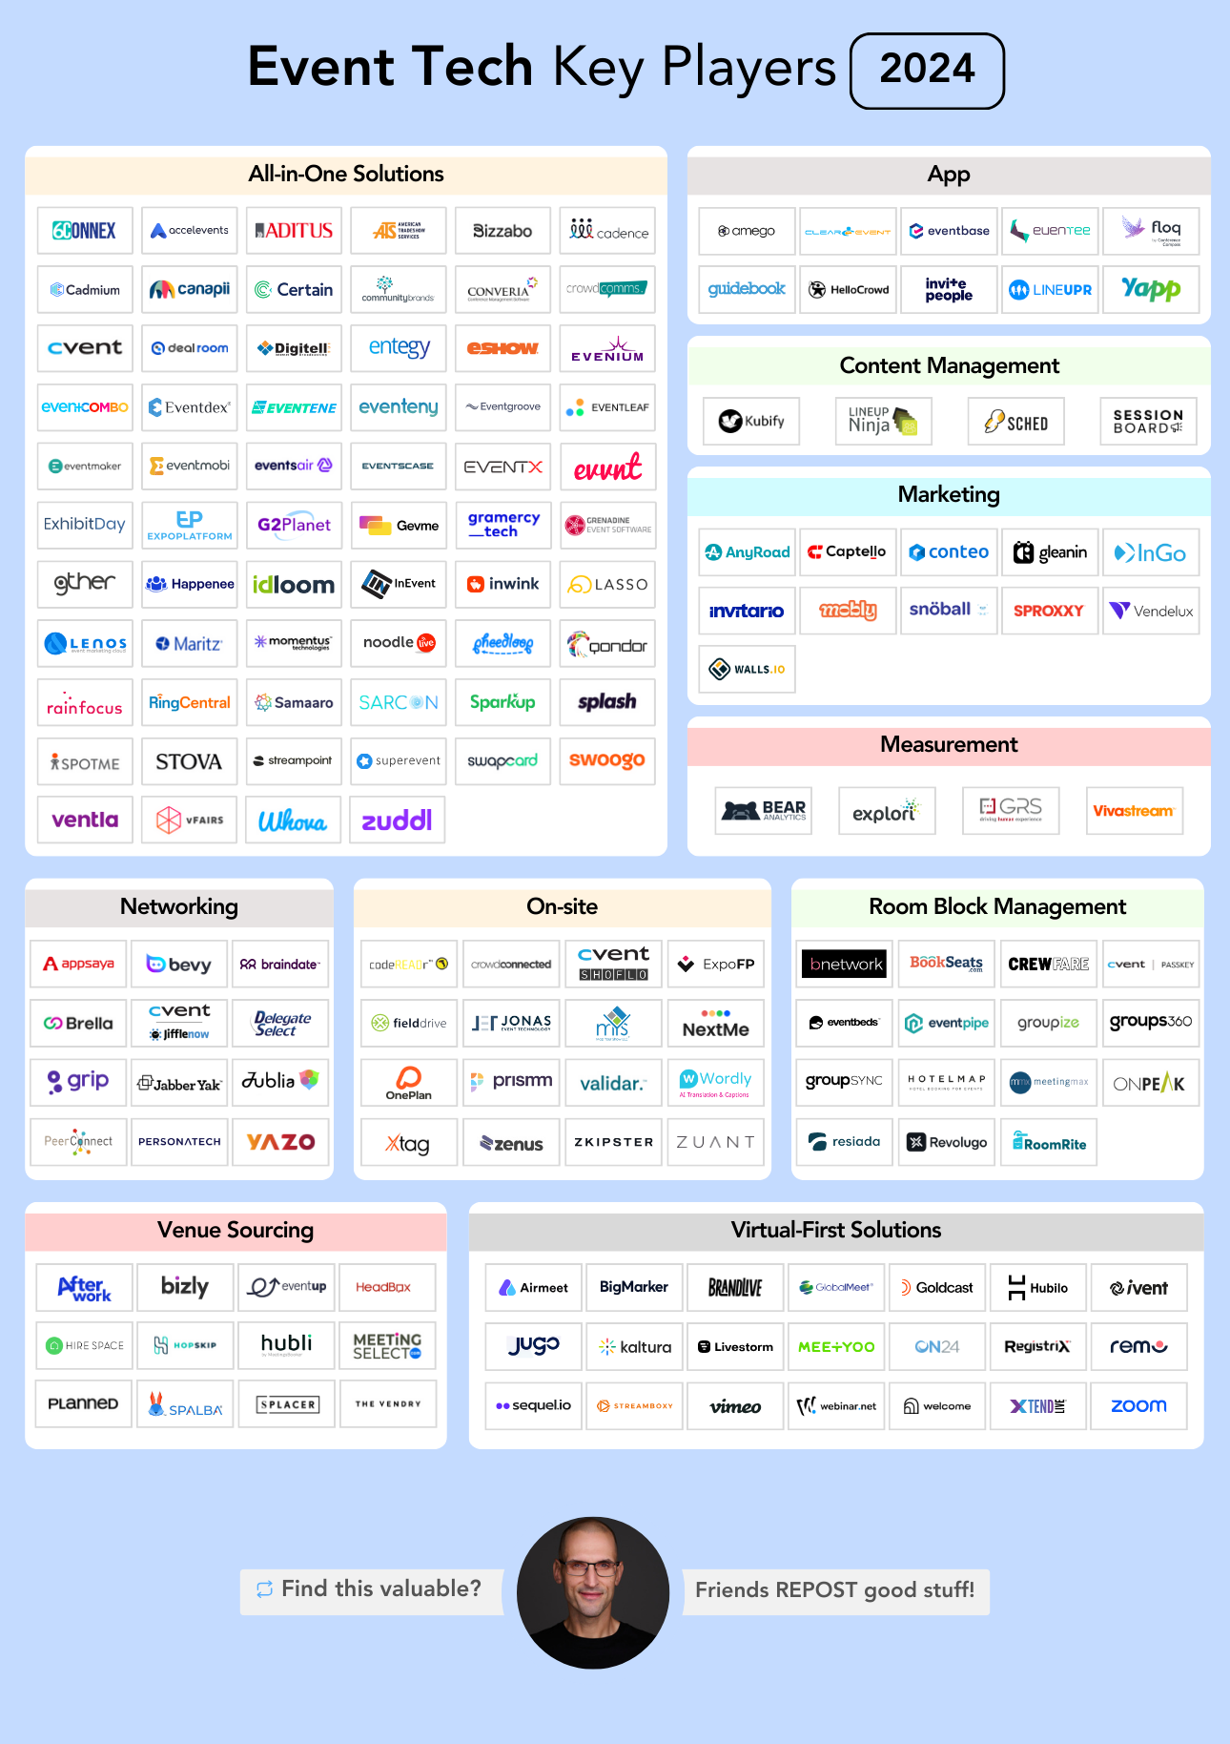
Understand the
Ecosystem

Slide 80




DROP DUMB CONFERENCE BADGES
Automatic Session Check-in
Automatic Heat Maps
Easy Contact Exchange
(Bizzabo says +250%)
More Leads
(Bizzabo says +400%)

Slide 81
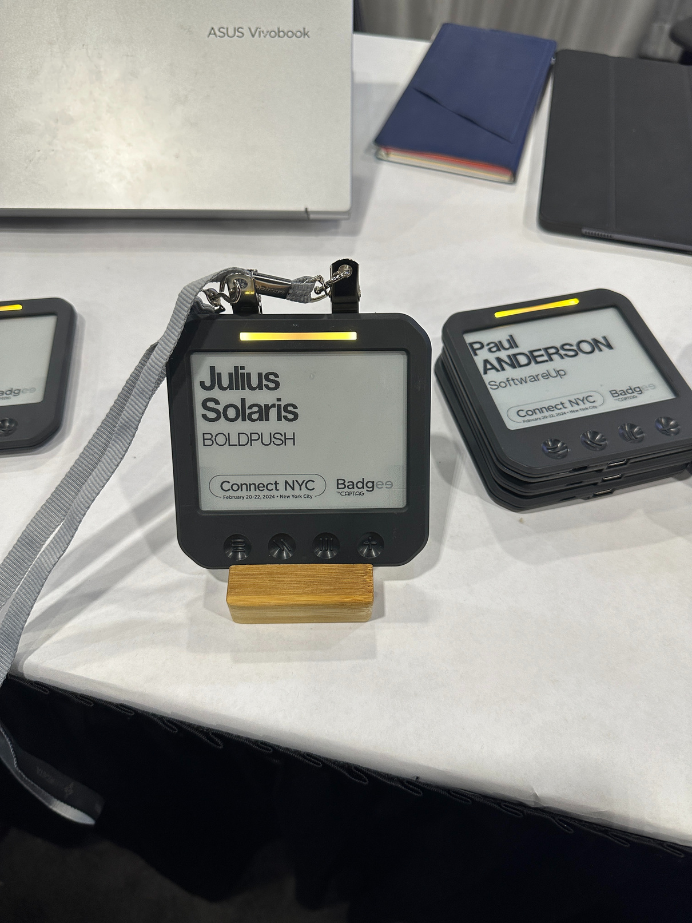
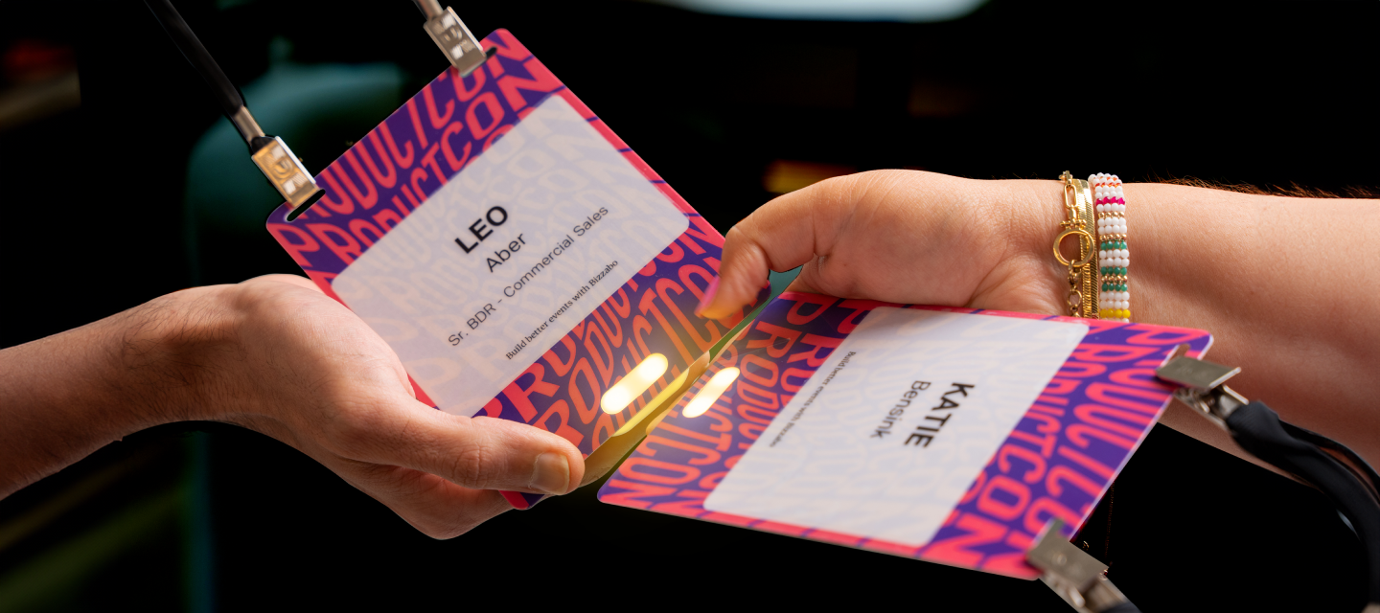
DROP DUMB BADGES

Slide 82








Only long or very large events need event apps.
It’s not 2012 anymore.
JULIUS
SOLARIS
LOGO
BOLD PUSH
FOUNDER
LOS ANGELES, USA
I AM INTERESTED IN
________________
SPEAKER
SPONSOR
PREMIUM MEMBER
Use QR Codes for Agenda and Map

Slide 83

I don’t attend Zoom Calls
in-person

Slide 84




70%
new workers in 4 years

Slide 85

THANK YOU!
Julius Solaris

Slide 86
Get the slides + 8 Frameworks

Slide 87
Q&A
Julius Solaris

