Slide 1
IT RENTALS FOR STAFFING AGENCIES
Flexible. Secure. Scalable.

Slide 2
The REALITY OF STAFFING TODAY
Speed and flexibility aren’t optional; they’re operational requirements.
Technology must:
Deploy quickly
Scale up or down on demand
Protect sensitive data
Avoid burdening internal teams
Technology should enable placements, not delay them.

Slide 3
The Problem with Traditional Leasing
Leasing was not built for staffing.
Typical leasing includes:
Long-term contracts
Buyout structures
Limited service and support
Internal device management
Capital lock-in
This model limits flexibility and adds operational strain.

Slide 4
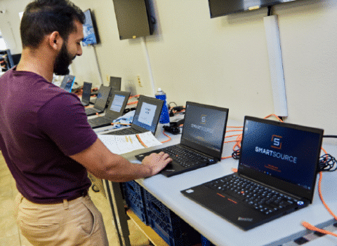
The Smartsource difference
We Provide a True Device-as-a-Service Model
We deliver:
Flexible terms (days, months, longer-term)
No ownership obligation or buyouts
Full lifecycle management
  Sourcing
  Configuration
  Software Loading
  Deployment
  Support
  Data Destruction
We manage the equipment. We manage the logistics. We manage the security.

Slide 5
Built Around the Needs of Staffing Agencies
You don’t just need laptops; you need a system.
Our Device-as-a-Service model delivers:
Rapid, scalable deployment
Security & compliance built in
24/7 support
Financial flexibility
One partner. One process. Total accountability.
Equipment & Deployment
Flexible devices, rapid configuration, scalable volume.
Security & Compliance
Multi-pass data destruction, chain-of-custody, audit-ready documentation.
Software & Imaging
Pre-installed OS, required applications, and custom imaging.
Reporting & Visibility
Asset tracking and remote device management.
24/7 Support
Dedicated help desk and rapid replacement.
Turnkey Logistics
Direct shipping, pre-labeled returns, secure retrieval.

Slide 6

The Financial Advantage
Benefits include:
Lower upfront investment
Preserved capital for growth initiatives
No depreciation expense
No idle equipment in storage
Scalable costs aligned to demand
Ideal for seasonal hiring and project-based surges.
Rentals fall under OpEx, not CapEx.

Slide 7
Rapid Deployment & Equipment Flexibility
Technology that matches the speed of staffing.
Device Range
Standard to high-performance devices tailored to role requirements
Custom Configuration
Imaging, software loading, and branding completed before shipment.
Direct-to-Remote Shipping
Devices ship directly to candidates — no office stop required.
Volume Scalability
Scale up or down instantly to match placement volume.
Same-Day Turnaround
Imaging, software loading, and branding completed before shipment.

Slide 8
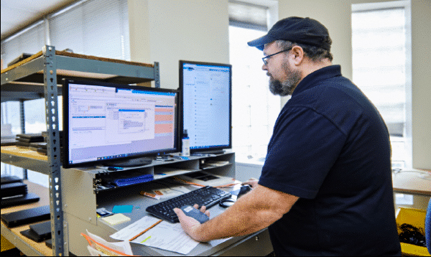

Security, Compliance & Visibility
Secure multi-pass data destruction
Optional DoD 7-pass wipe
Certificates of Data Destruction
Chain-of-custody procedures
Asset tracking & remote device locking
Protecting candidate and client data at every stage.

Slide 9
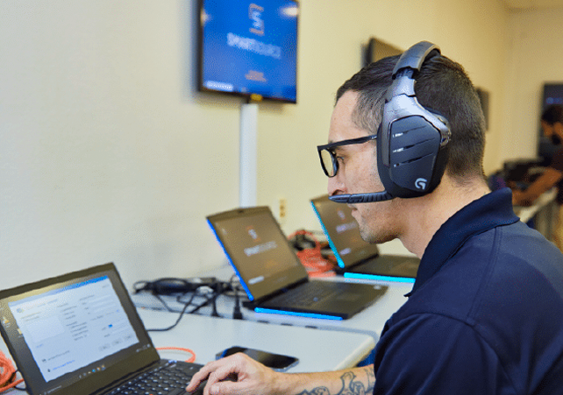
End-to-End Support & Logistics
24/7 Dedicated Help Desk
A team that knows your agency, available around the clock.
Rapid Device Replacement
  Failed device? A replacement ships immediately — minimal downtime.
Turnkey Returns
  Pre-labeled packaging and secure retrieval — candidates just box and ship.
Secure Redeployment
  Returned devices are wiped, verified, and made ready for the next placement.
We remove the operational burden from your team.

Slide 10

Built to Scale Nationwide
Consistent execution at scale.
Staffing demand changes quickly.
SmartSource supports:
Multi-city deployments
Nationwide coverage
Direct-to-remote employee shipping
Dedicated account management

Slide 11
A Partner, Not Just a Provider
We manage the equipment, logistics, security, and support, so you can focus on business.
WE DELIVER
YOU FOCUS ON
Full Device-as-a-Service model
Rapid deployment
Secure data destruction
Dedicated help desk
Placing talent
Growing revenue
Servicing clients
We’ll handle the rest.

Slide 12
IT RENTALS FOR STAFFING AGENCIES
Flexible. Secure. Scalable.

